Slide 1
GRNmap Testing and Results
Natalie Williams
Brandon Klein
Mentors: K. Dahlquist, Ph.D. and B. Fitzpatrick, Ph.D.
Departments of Biology and Mathematics
Loyola Marymount University
October 31, 2016

Slide 2
Last week, we tested GRNmap with our 5 database-generated Networks.
1) Input sheets were made for five database-derived networks (wt, dCIN5, dGLN3, dHAP4, dZAP1).
2) Model runs were performed for each network.
3) Preliminary results from the runs are presented here.
4) We will work towards developing an in depth analysis of these results in the coming weeks.

Slide 3
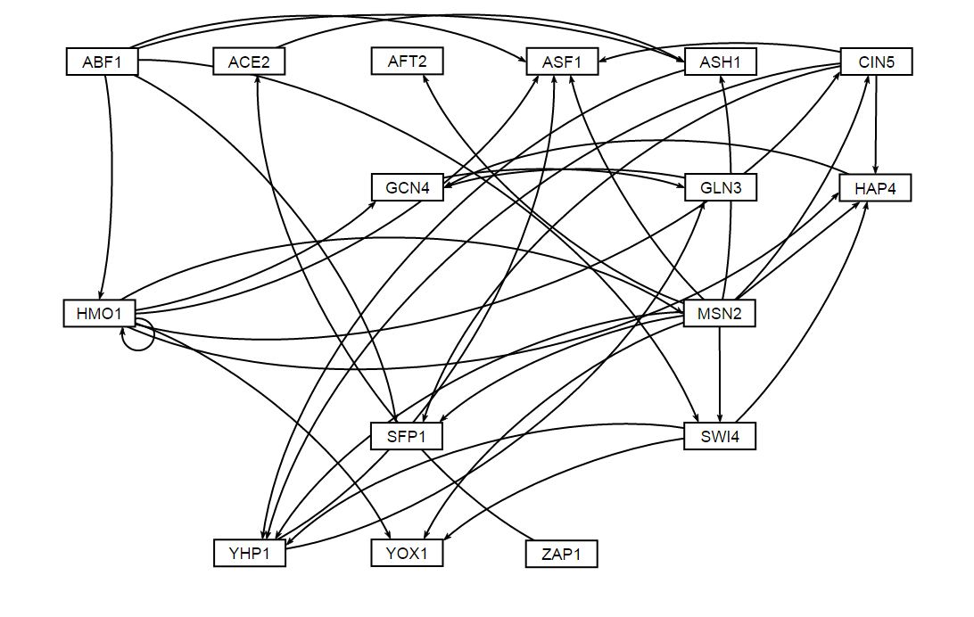
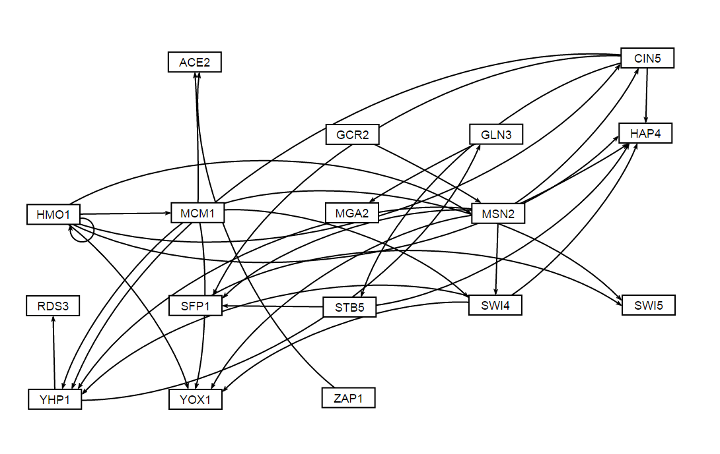
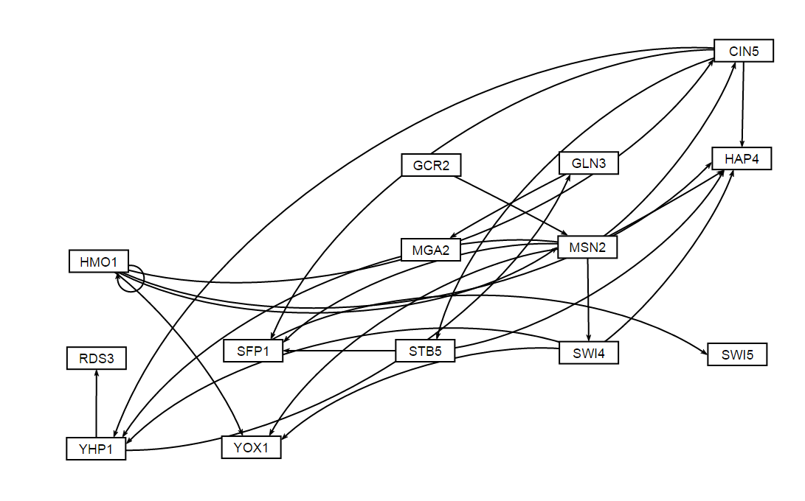
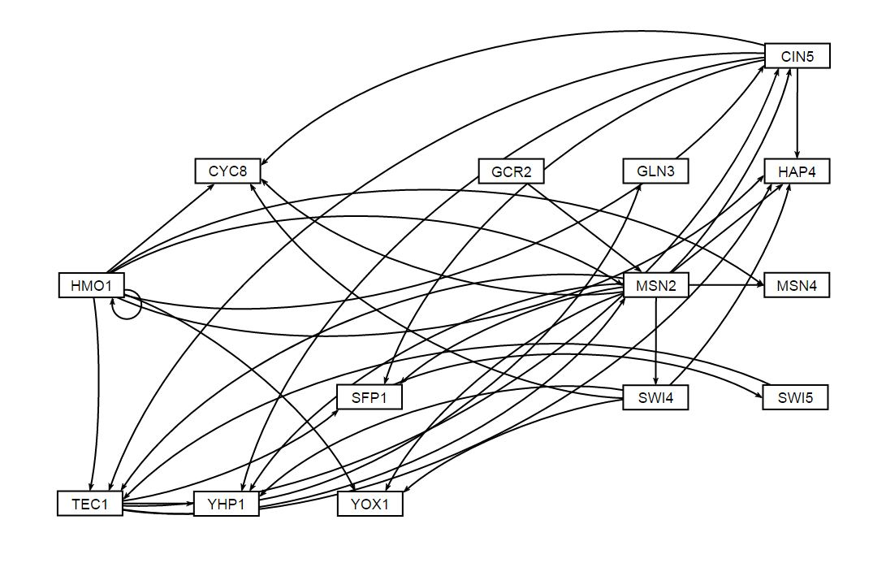
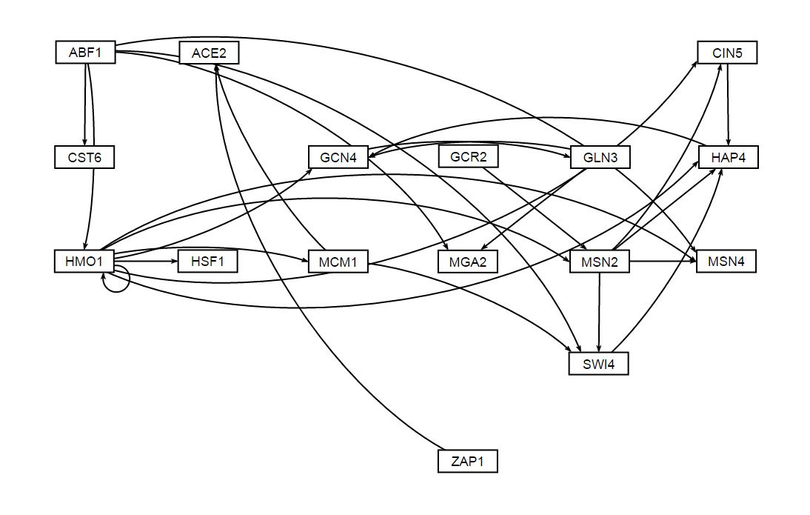
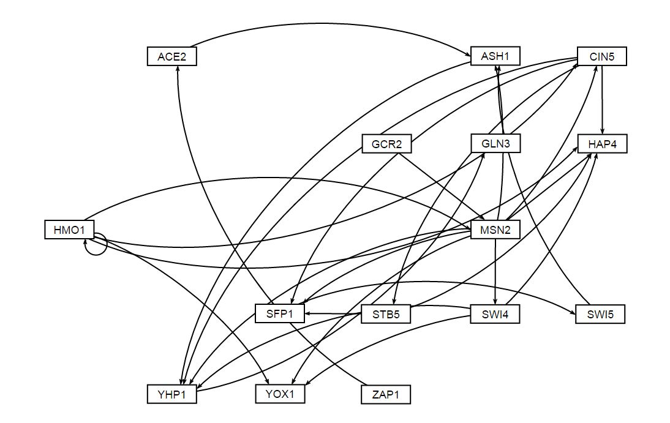
Unweighted visualization of the 5 database-generated GRNs via GRNSight
WT Unweighted Network
dCIN5 17-gene Unweighted Network
dCIN5 14-gene Unweighted Network
dGLN3 Unweighted Network
dHAP4 Unweighted Network
dZAP1 Unweighted Network

Slide 4
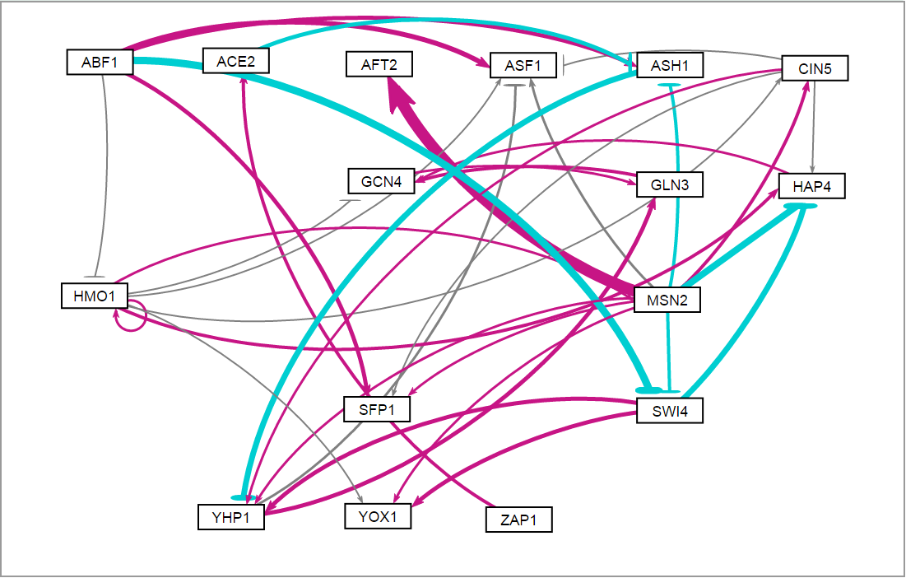
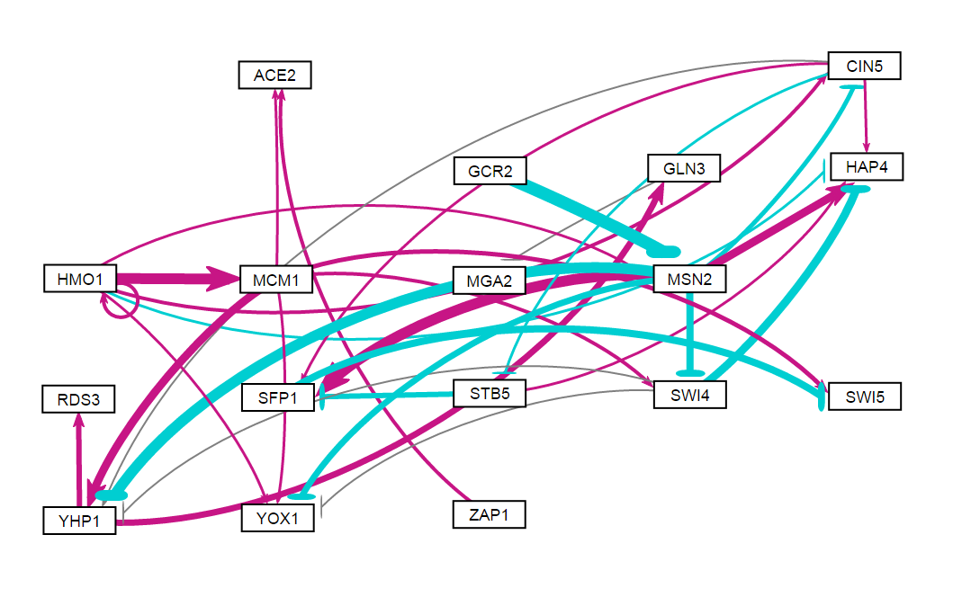
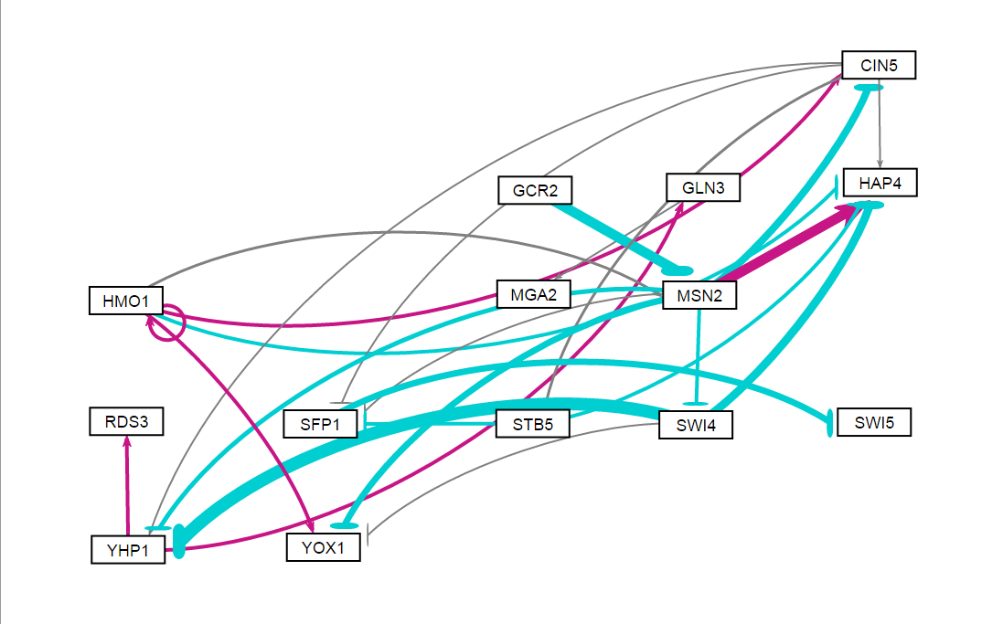
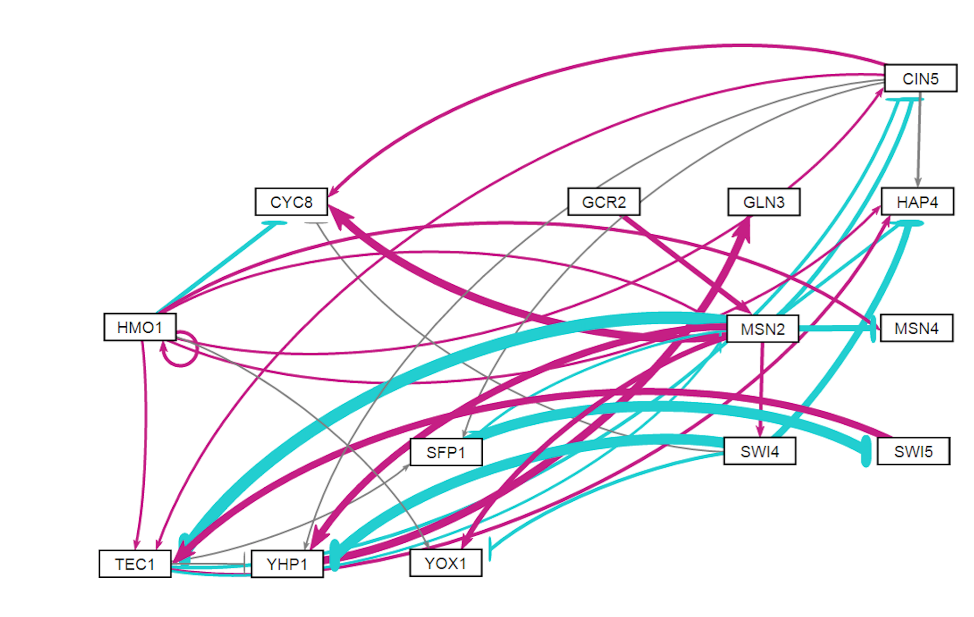
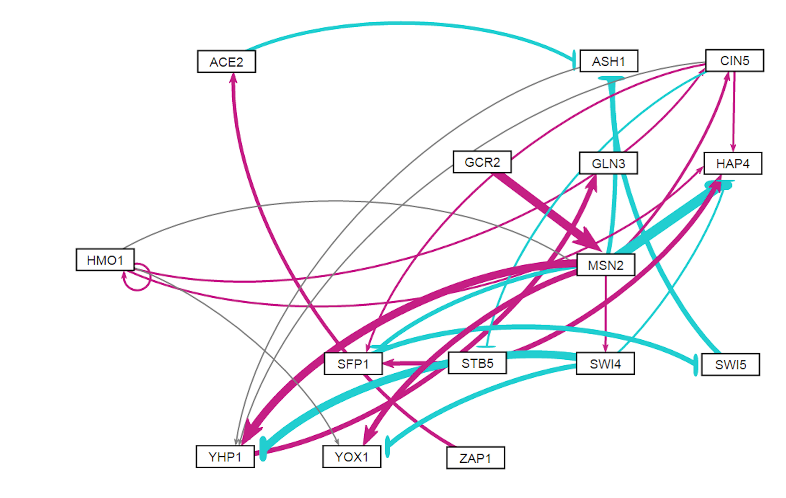
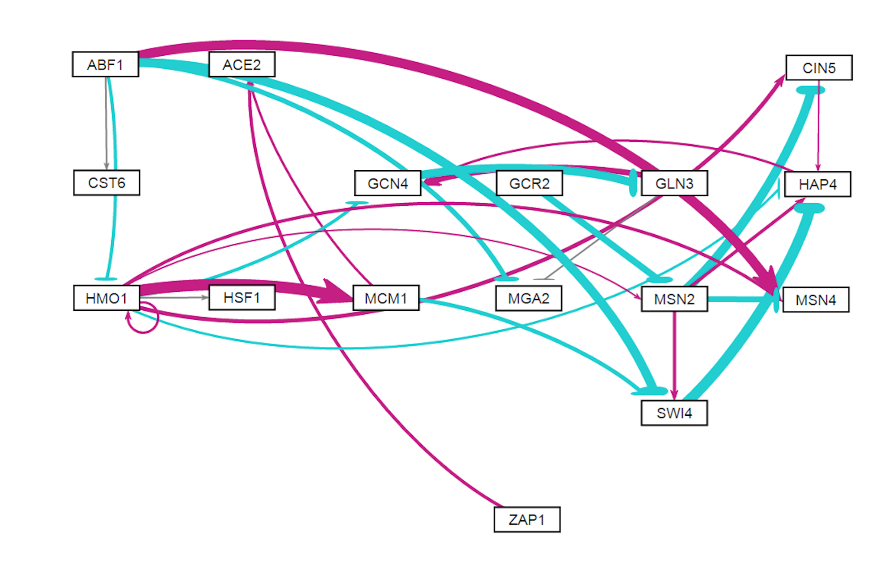
Weighted GRNSight visualizations of the database-derived GRNs from all 5 strains
WT Weighted Network
dCIN5 17-gene Weighted Network
dCIN5 14-gene Weighted Network
dGLN3 Weighted Network
dHAP4 Weighted Network
dZAP1 Weighted Network

Slide 5
WT GRNmap Testing Results
As of: 2016 Oct. 30
WT Information:
16 Nodes (Genes)
36 Edges
Network composed of the following genes:
ABF1
ACE2
AFT2
ASF1
ASH1
CIN5
GCN4
GLN3
HAP4
HMO1
MSN2
SFP1
SWI4
YHP1
YOX1
ZAP1

Slide 6
Parameter Outputs - WT
Parameter | Value
Penalty Term | 2.5923
LSE | 0.8194
minLSE | 0.5768
LSE:minLSE ratio | 1.4206
Iteration Count | 109,718

Slide 7
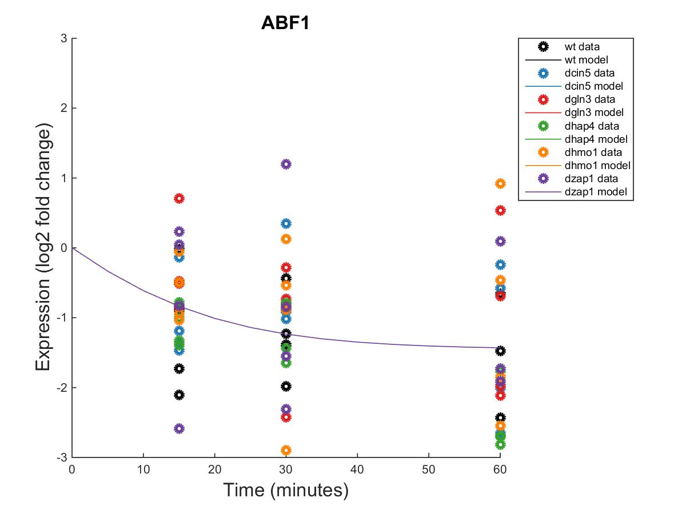
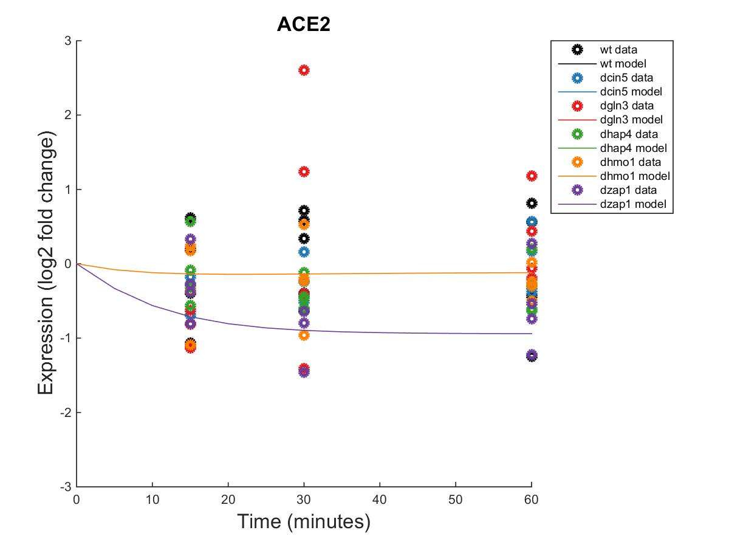
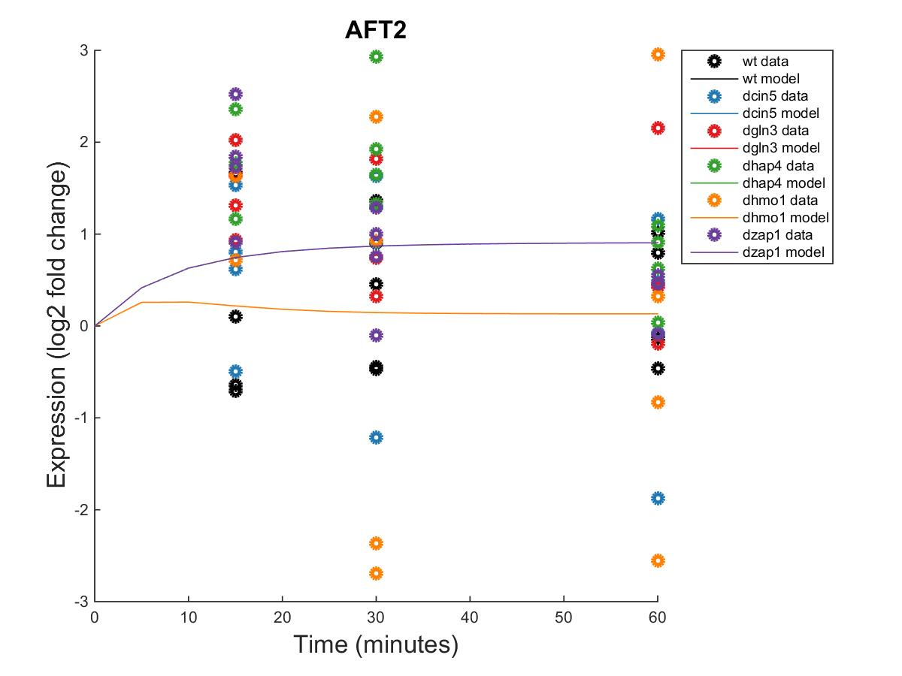
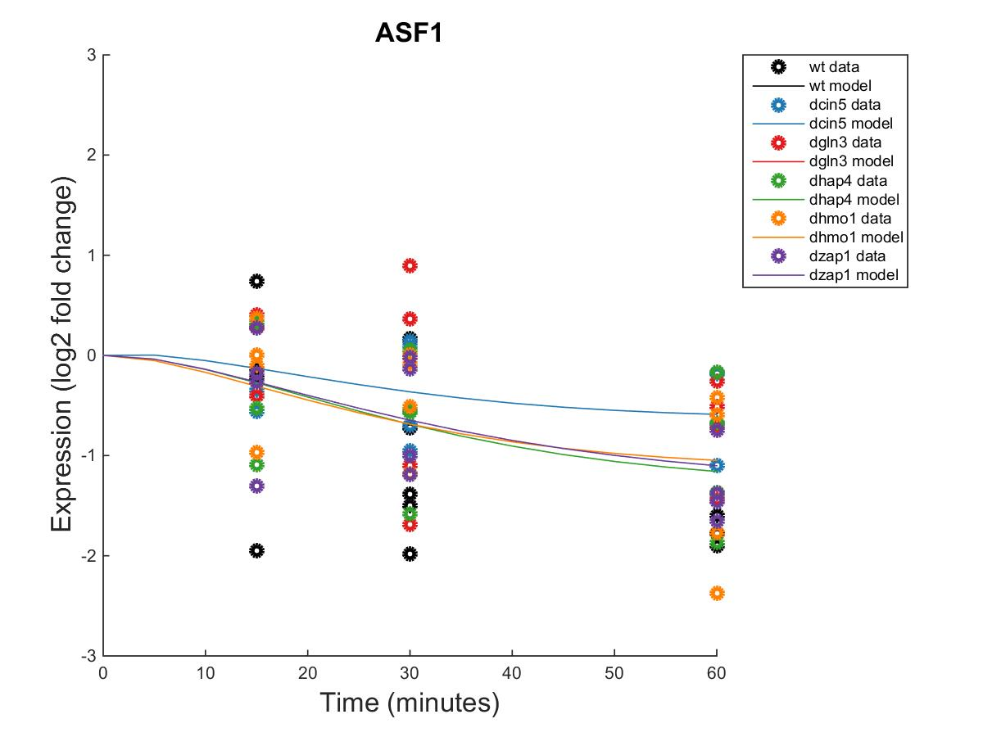
GRNmap Output Estimation of ABF1, ACE2, AFT2, AND ASF1
Within Strain ANOVA
0.0055
0.0148
0.1095
0.0004
0.5993
0.0895
Within Strain ANOVA
0.7624
0.4462
0.7855
0.2916
0.8258
0.0457
Within Strain ANOVA
0.9361
0.7004
0.0343
0.0045
0.993
0.0159
Within Strain ANOVA
0.0298
0.4193
0.4165
0.2305
0.8447
0.1669

Slide 8
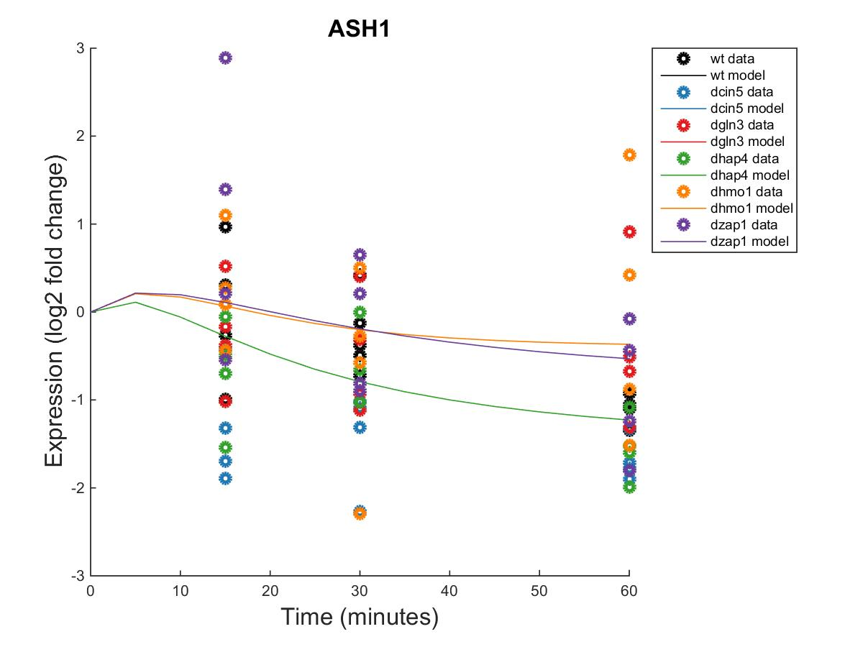
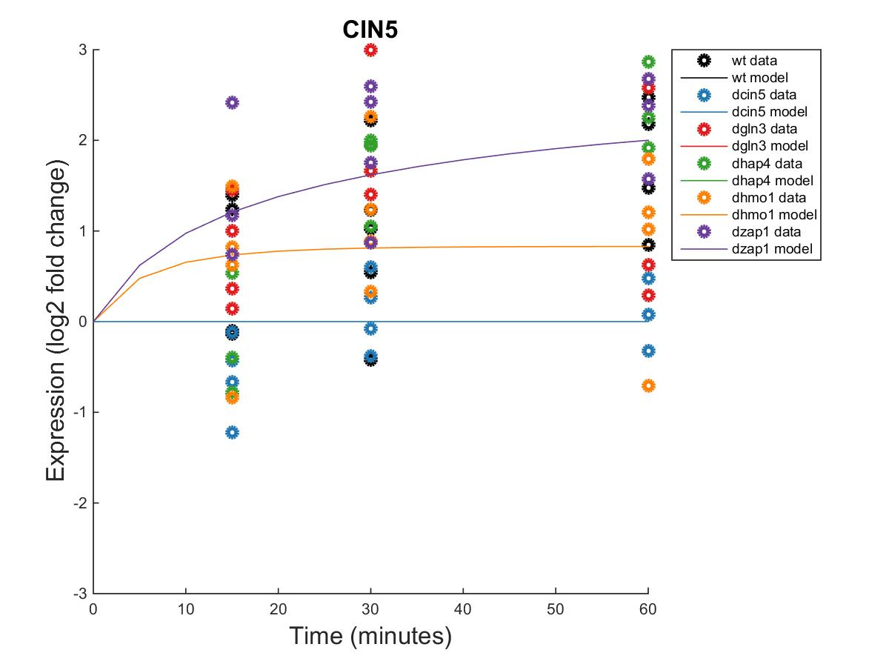
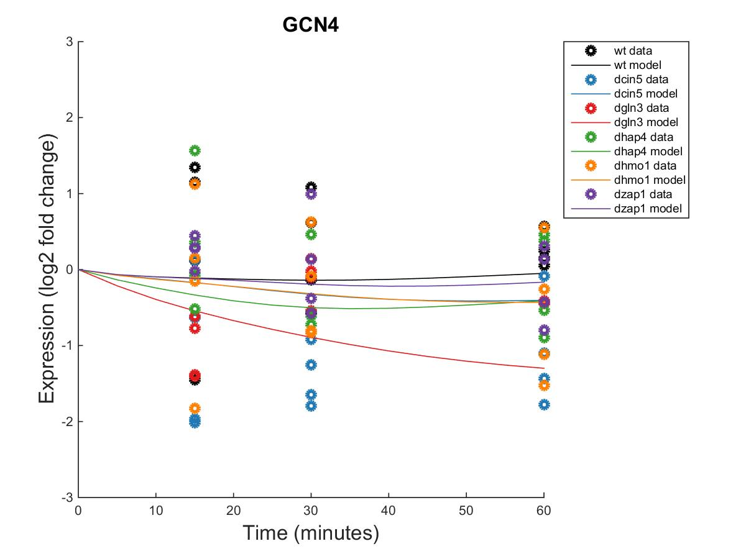
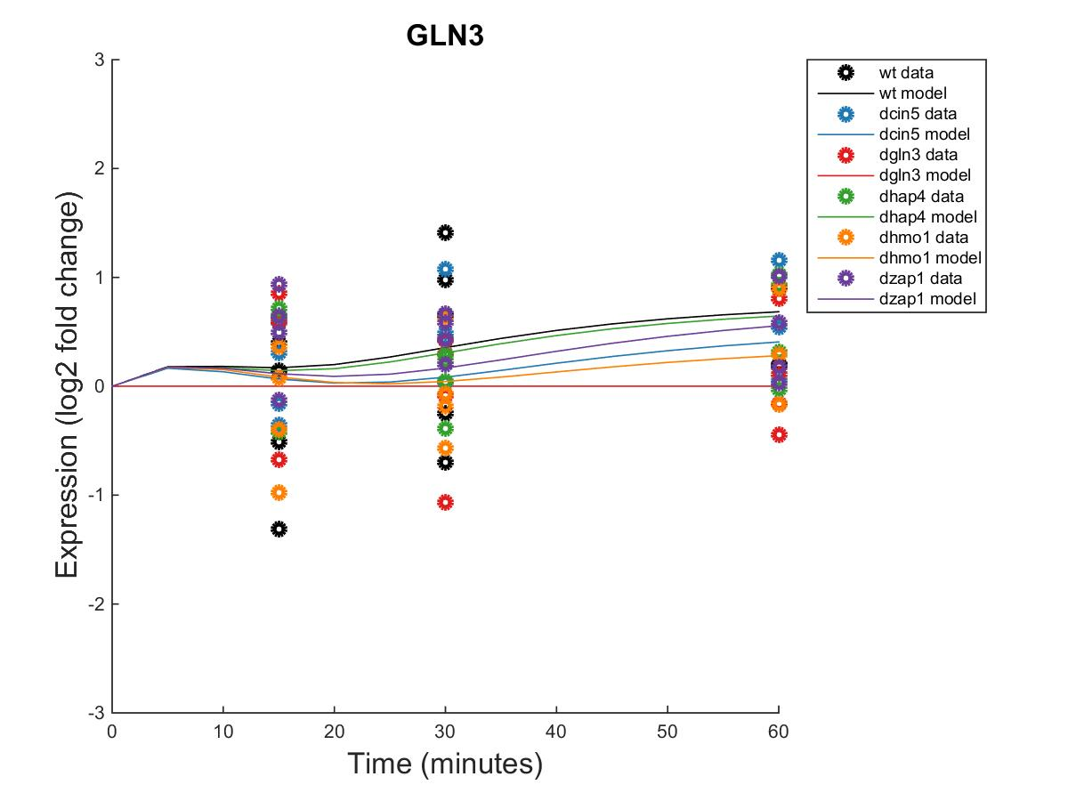
GRNmap Output Estimation of ASH1, CIN5, GCN4, AND GLN3
Within Strain ANOVA
0.0829
0.0091
0.5202
0.0723
0.7639
0.4535
Within Strain ANOVA
0.0662
0.6188
0.0163
0.0112
0.4113
0.026
Within Strain ANOVA
0.6297
0.2761
0.2751
0.5058
0.9118
0.5207
Within Strain ANOVA
0.4189
0.5468
0.6094
0.5189
0.9281
0.1171

Slide 9
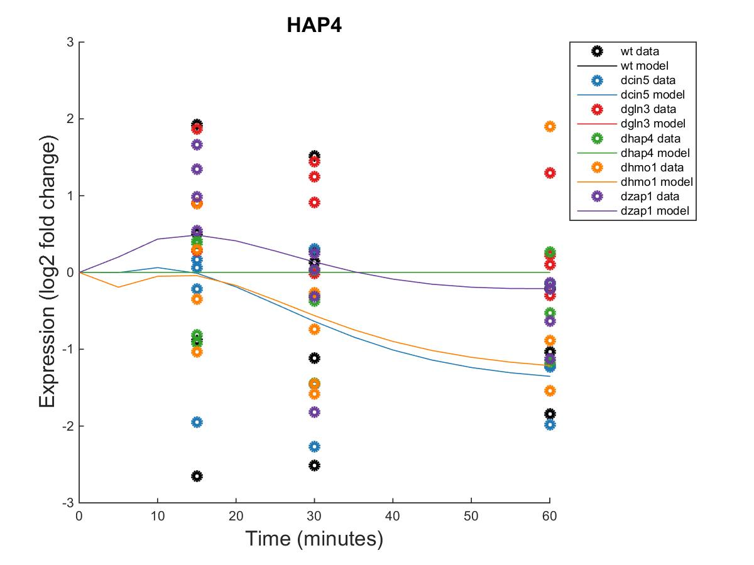
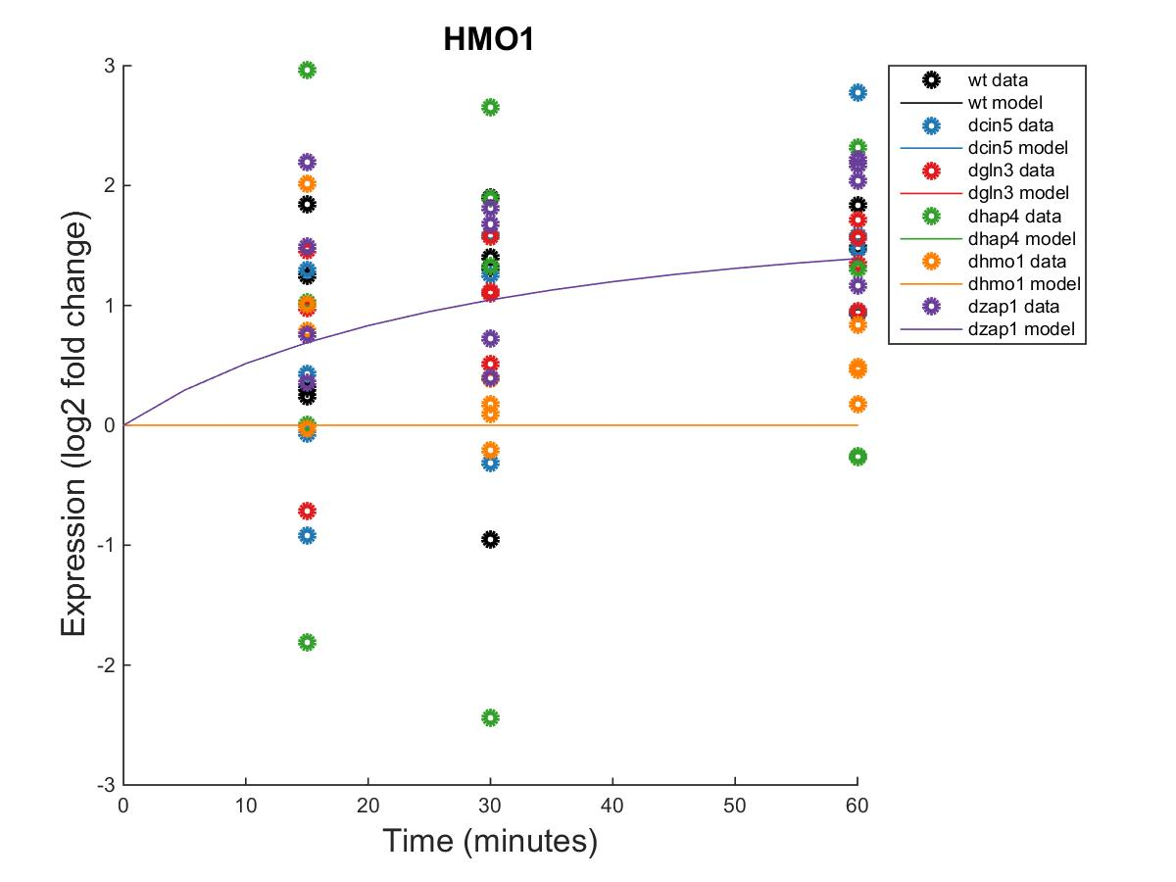
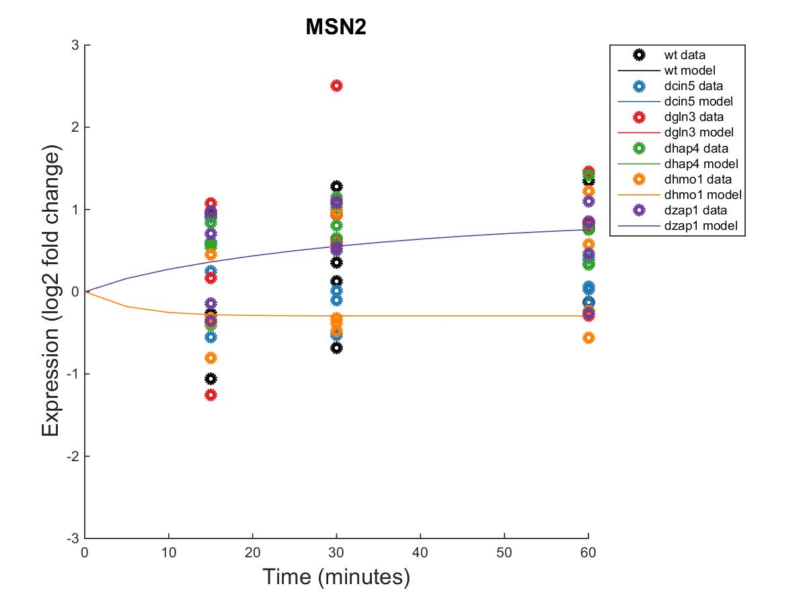
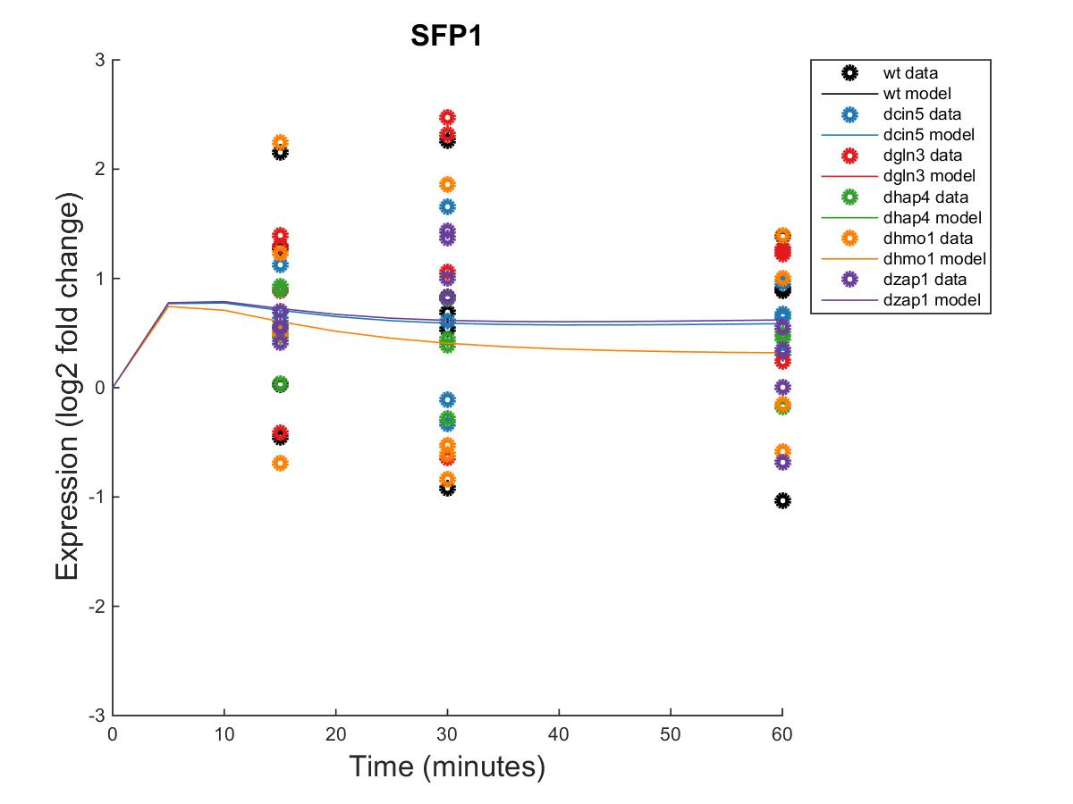
GRNmap Output Estimation of HAP4, HMO1, MSN2, AND SFP1
Within Strain ANOVA
0.7307
0.4821
0.0773
0.4165
0.9262
0.0157
Within Strain ANOVA
0.0397
0.0022
0.0025
0.4244
0.5758
0.0011
Within Strain ANOVA
0.3056
0.2208
0.3427
0.0168
0.8021
0.0836
Within Strain ANOVA
0.4097
0.0494
0.0751
0.0533
0.8354
0.0021

Slide 10
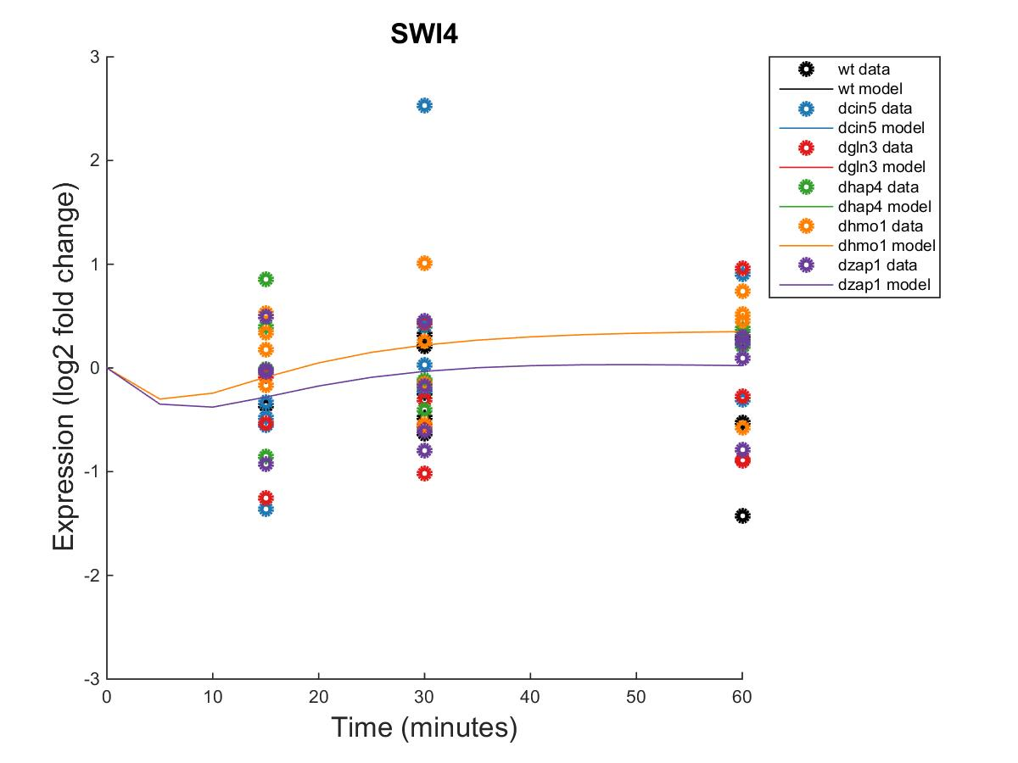
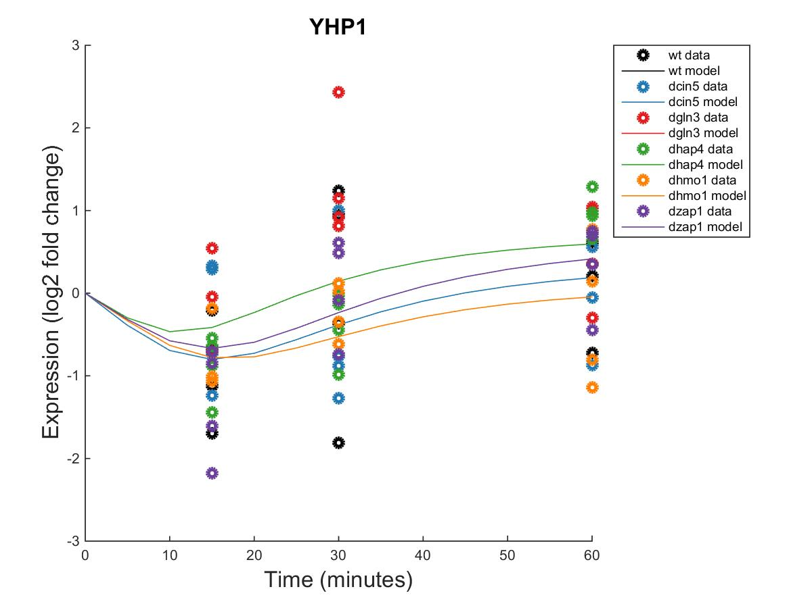
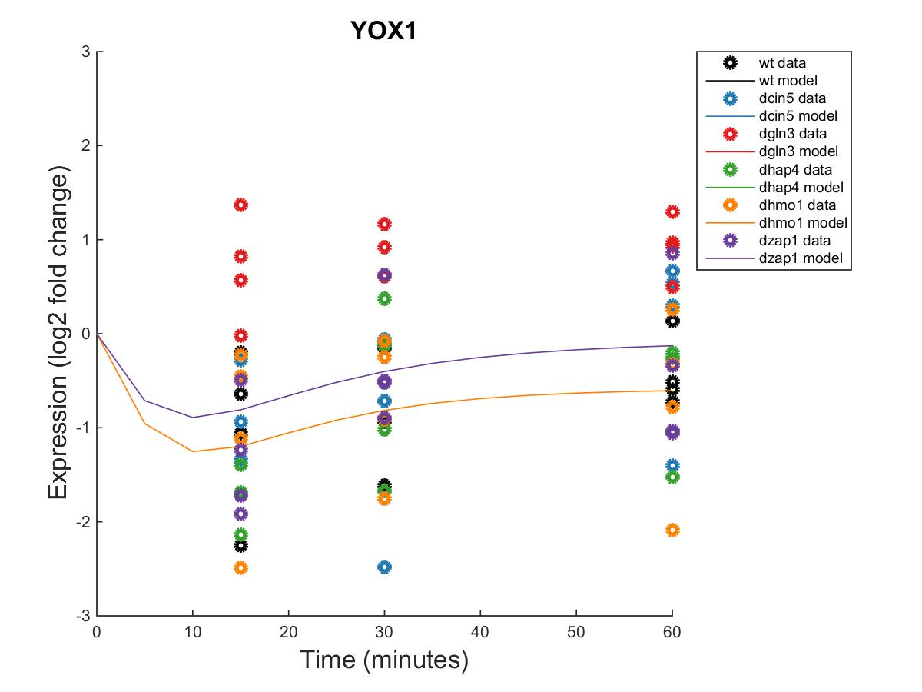
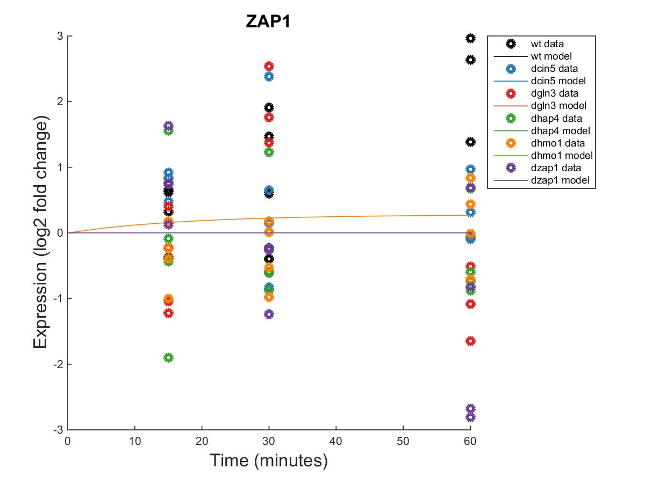
GRNmap Output Estimation of SWI4, YHP1, YOX1, AND ZAP1
Within Strain ANOVA
0.6731
0.4839
0.3797
0.6155
0.9652
0.7799
Within Strain ANOVA
0.1743
0.8684
0.0433
0.0084
0.8152
0.0653
Within Strain ANOVA
0.004
0.058
0.2181
0.0117
0.2197
0.2658
Within Strain ANOVA
0.0089
0.316
0.2503
1.0134
0.8824
0.4562

Slide 11
Weighted WT Network appears to have more activation than repression of genes within the network.

Slide 12
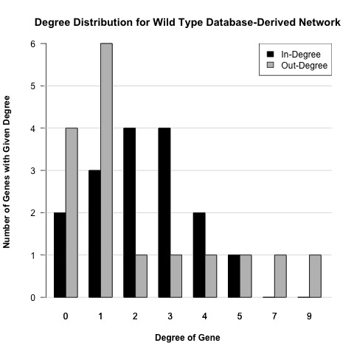

Slide 13
Optimized Production Rates and Threshold B Values for wt Network
id | production_rate | threshold_b
ABF1 | 0.0576 | 0.0576
ACE2 | 0.1339 | 0.2621
AFT2 | 0.2900 | 4.5169
ASF1 | 0.1582 | 1.3581
ASH1 | 1.5299 | 0.7641
CIN5 | 1.1528 | 2.6976
GCN4 | 0.1812 | 2.4228
GLN3 | 0.3601 | 1.3441
HAP4 | 2.3448 | -1.7451
HMO1 | 0.4833 | 1.3129
MSN2 | 0.5739 | 0.8961
SFP1 | 1.0066 | 1.2433
SWI4 | 0.2278 | -3.3941
YHP1 | 0.1513 | 0.3128
YOX1 | 0.7856 | 2.9816
ZAP1 | 0.1265 | 0.1265

Slide 14
dCIN5 17 gene GRNmap Testing Results
As of: 2016 Nov. 16
dCIN5 Information:
17 Nodes (Genes)
32 Edges
Network Composed of the following genes:
ACE2
CIN5
GCR2
GLN3
HAP4
HMO1
MCM1
MGA2
MSN2
RDS3
SFP1
STB5
SWI4
SWI5
YHP1
YOX1
ZAP1

Slide 15
Parameter Output
Parameter | Value
Penalty Term | 1.7570
LSE | 0.7864
minLSE | 0.5449
LSE:minLSE ratio | 1.4100
Iteration Count | 118,921

Slide 16
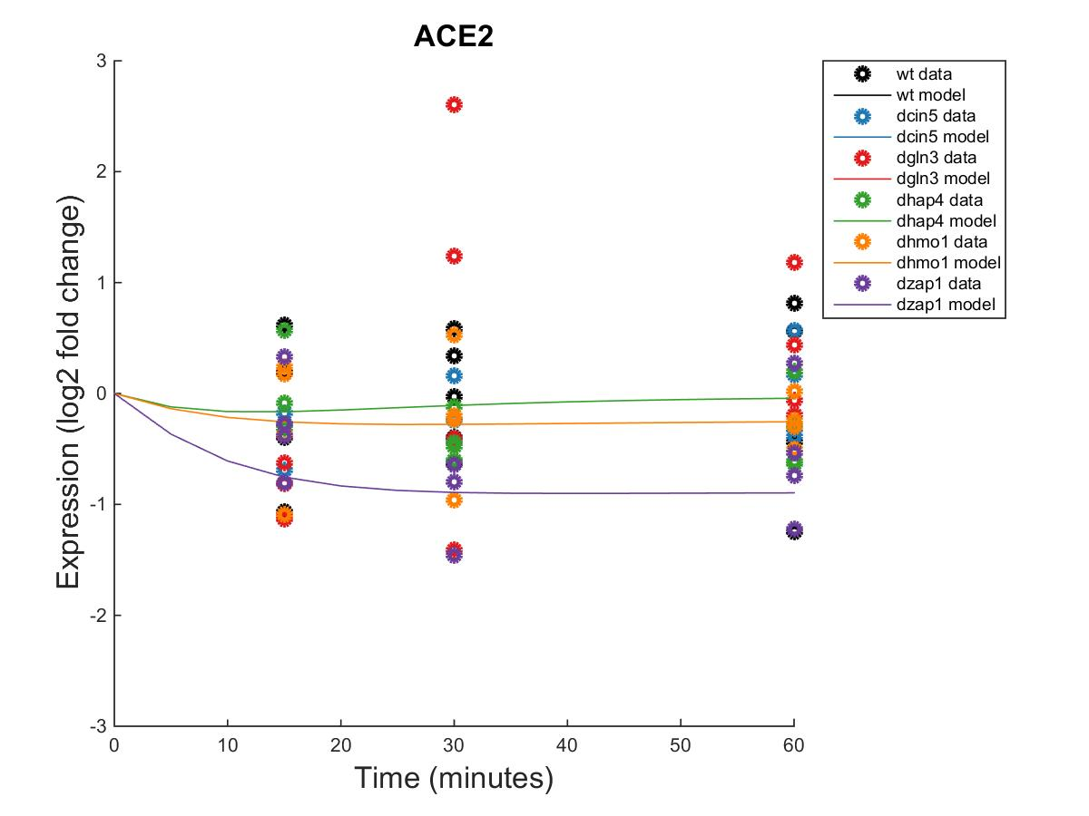
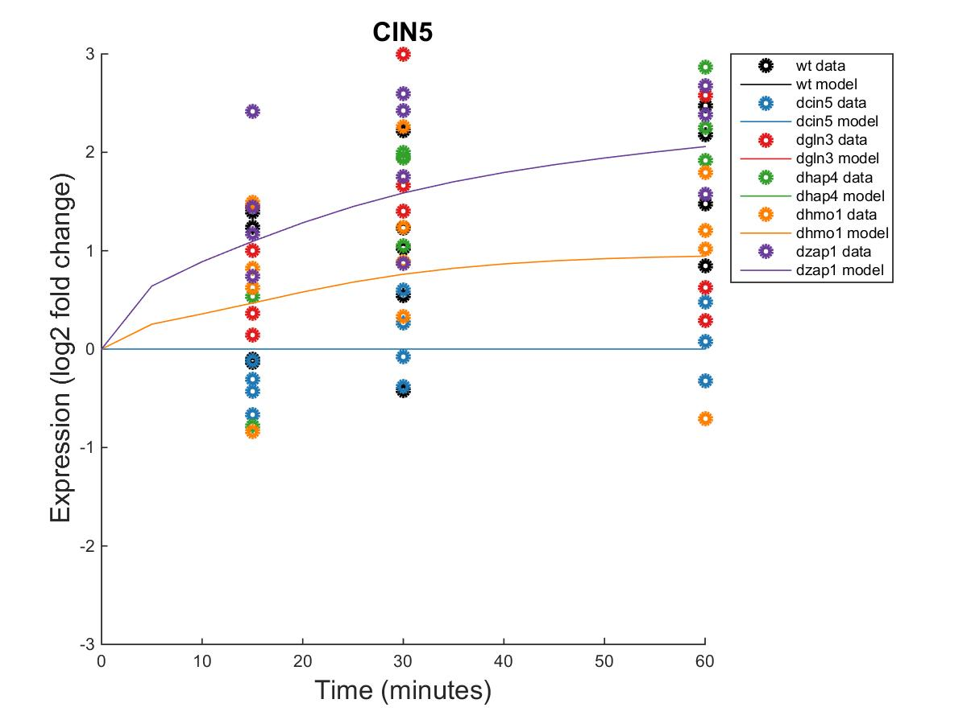
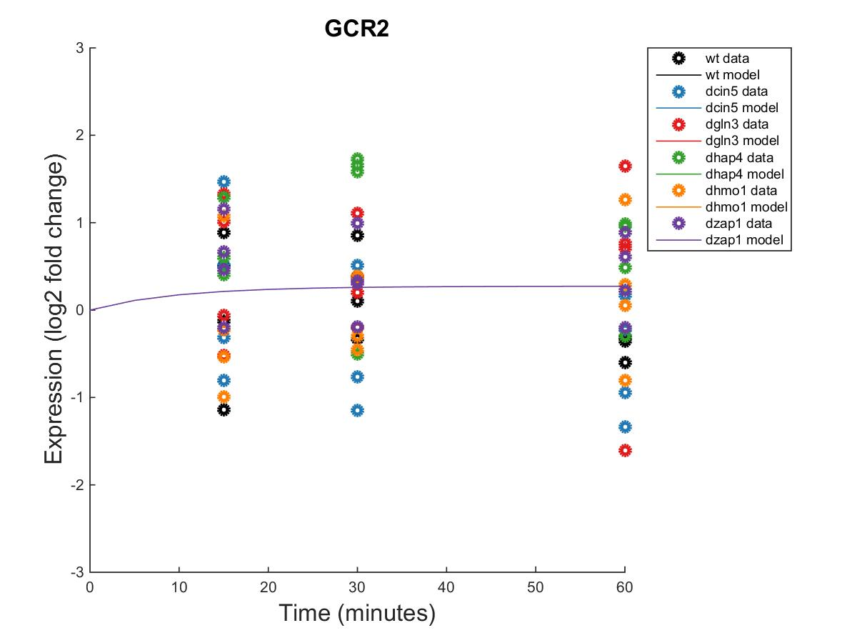
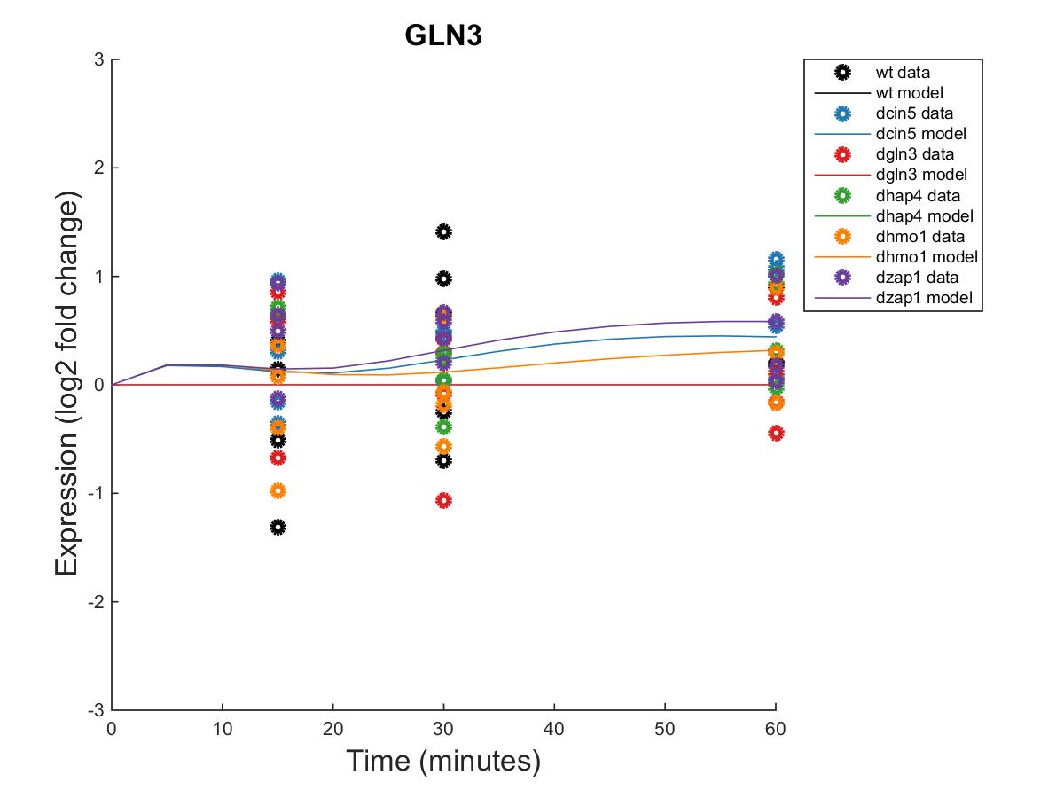
GRNmap Output Estimation of ACE2, CIN5, GCR2 AND GLN3

Slide 17
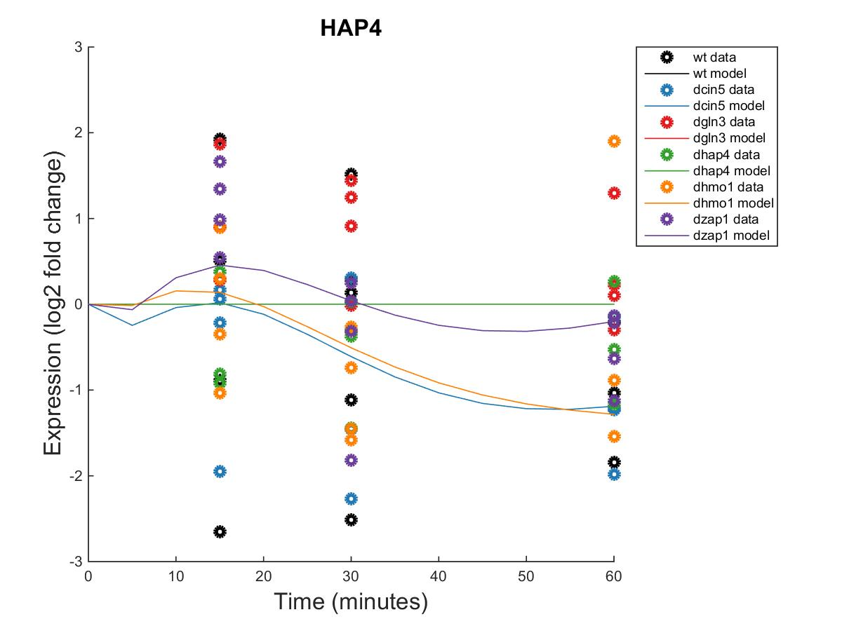
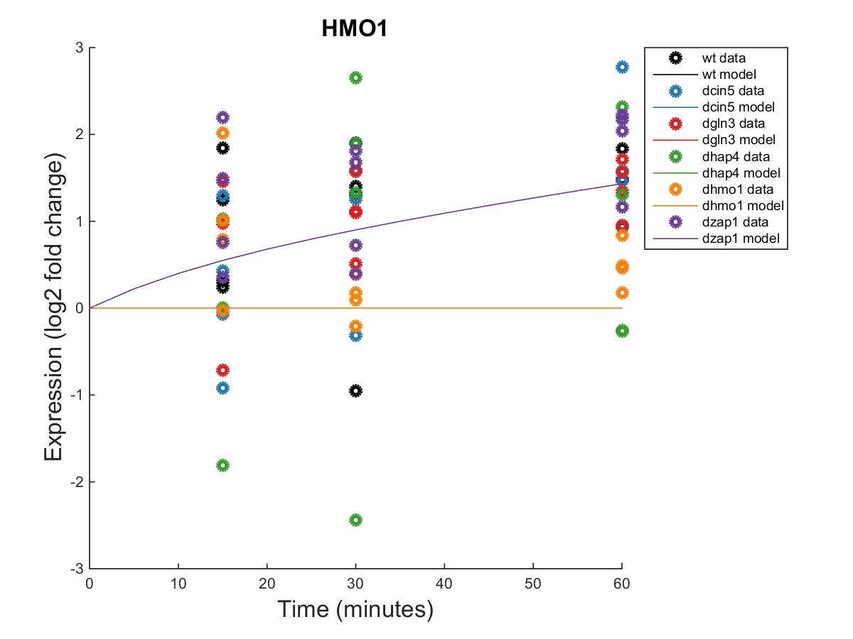
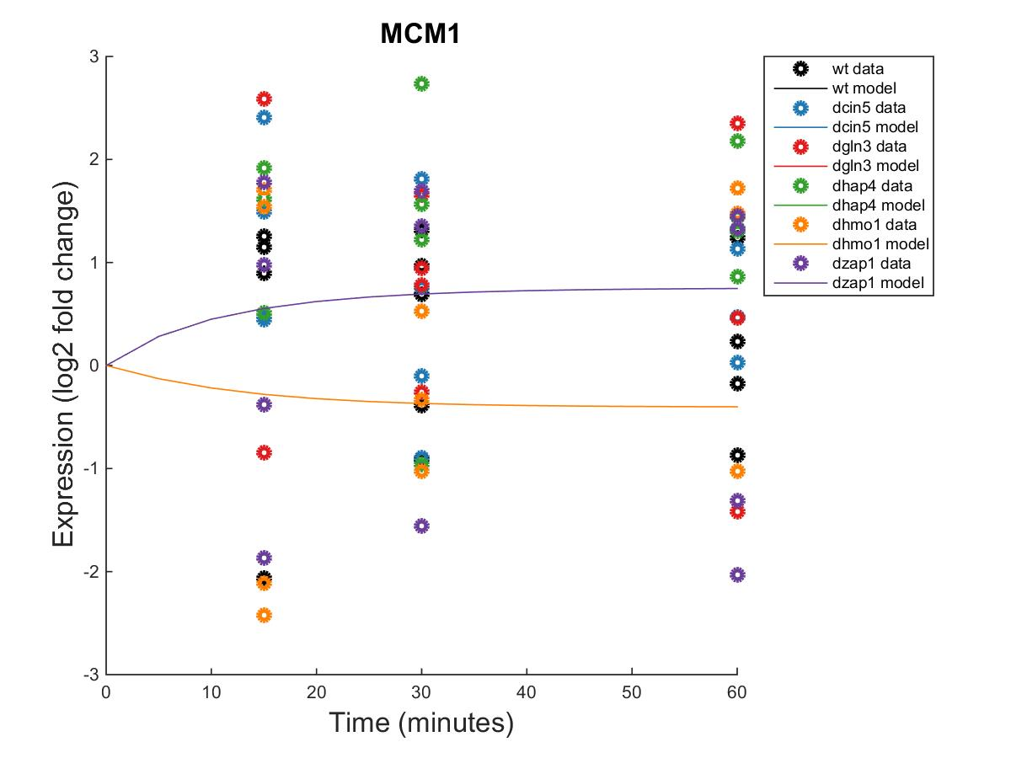
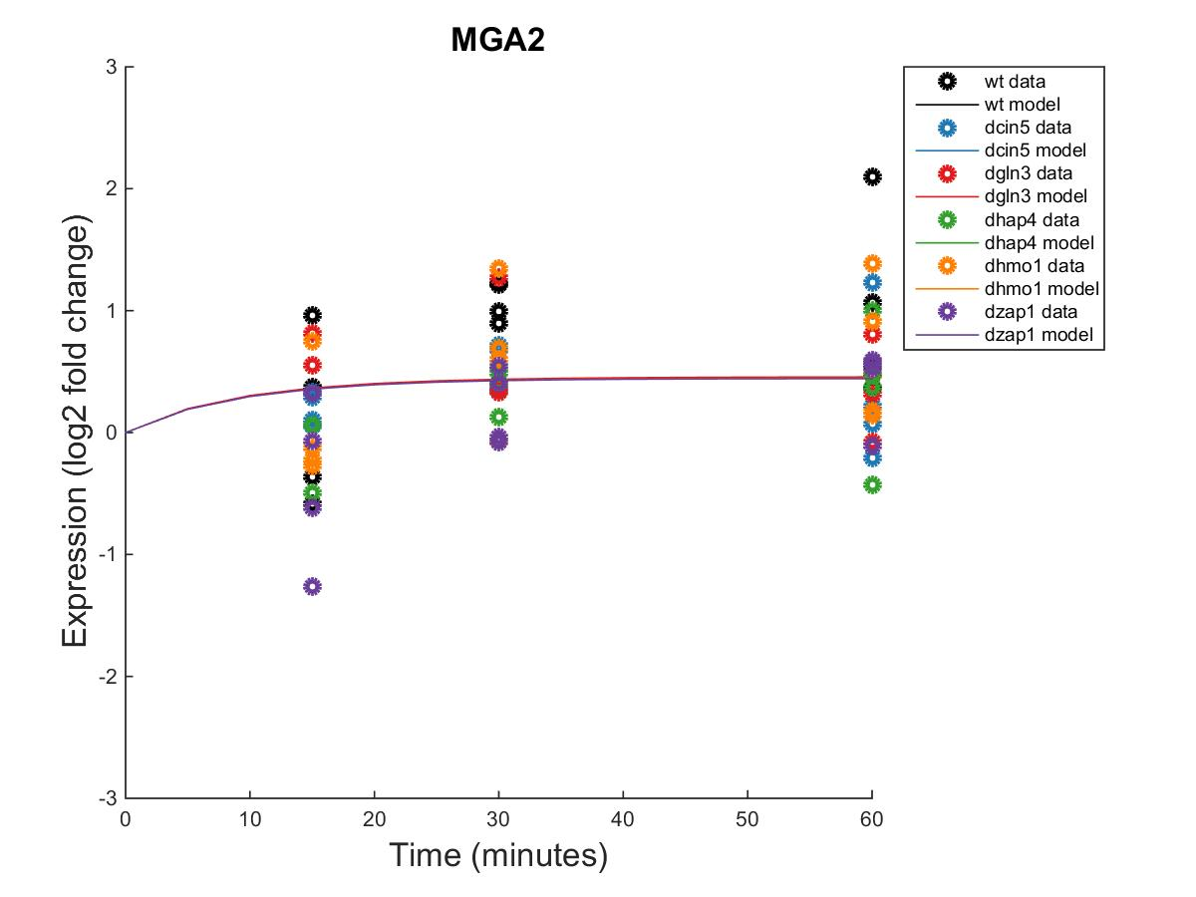
GRNmap Output Estimation of HAP4, HMO1, MCM1, and MGA2

Slide 18
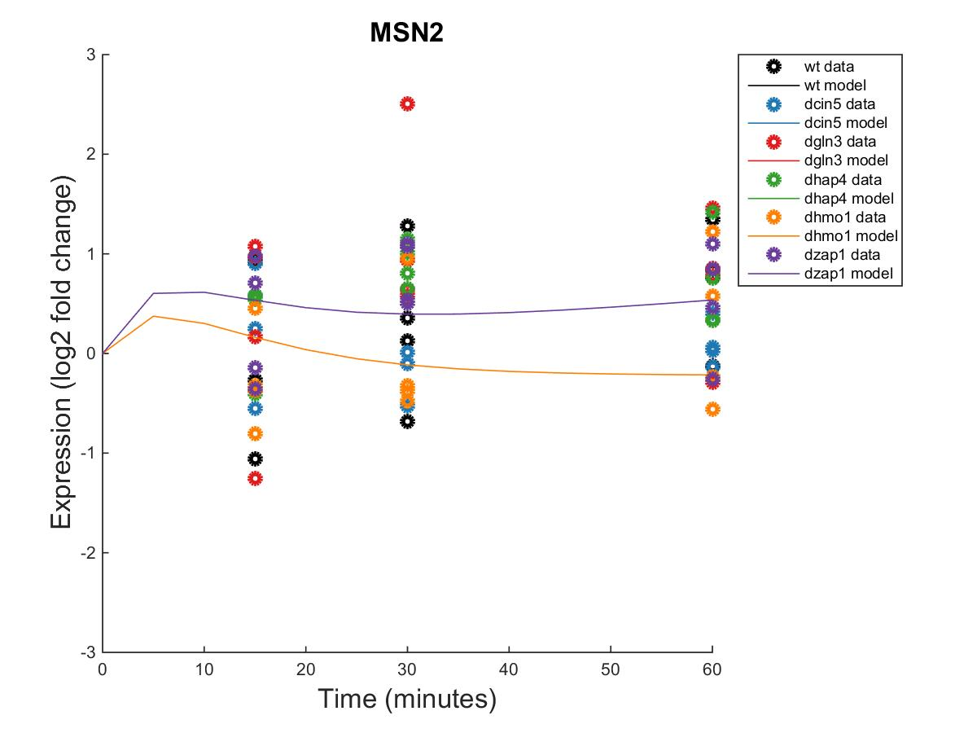
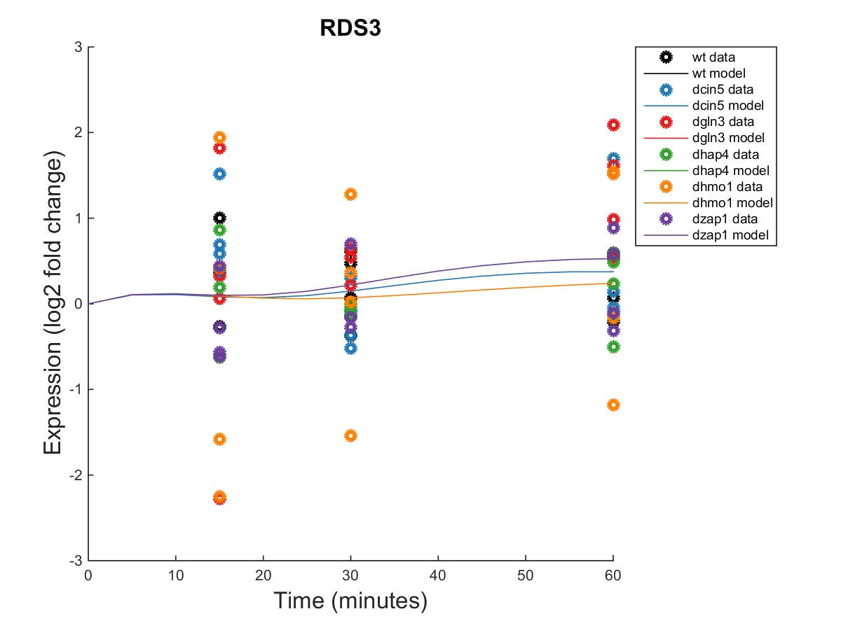
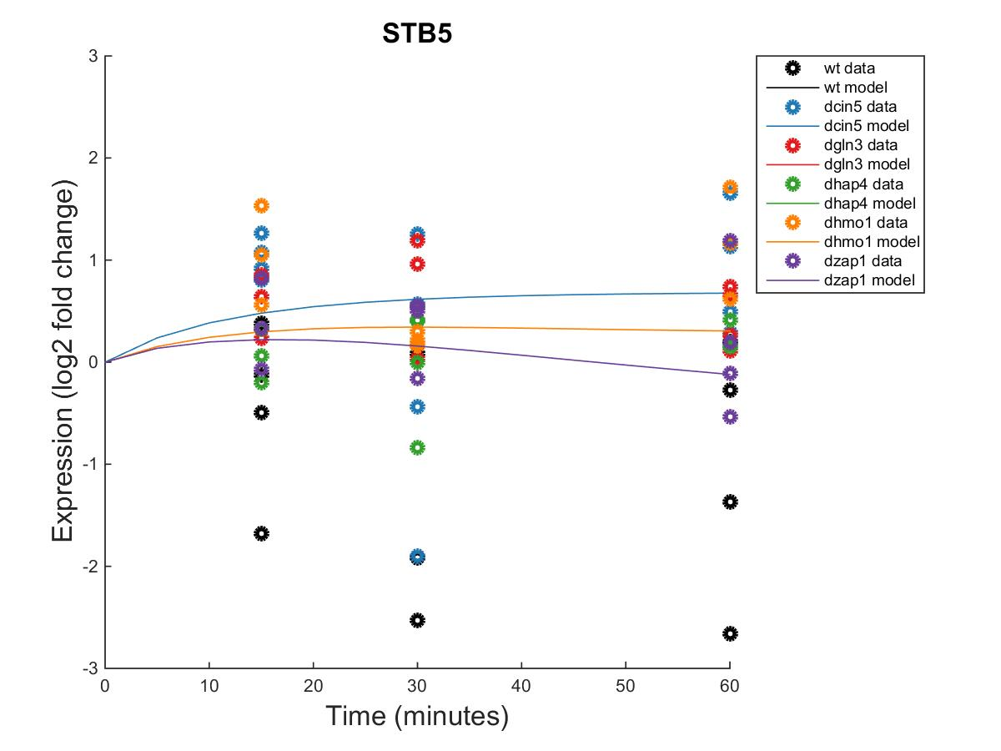
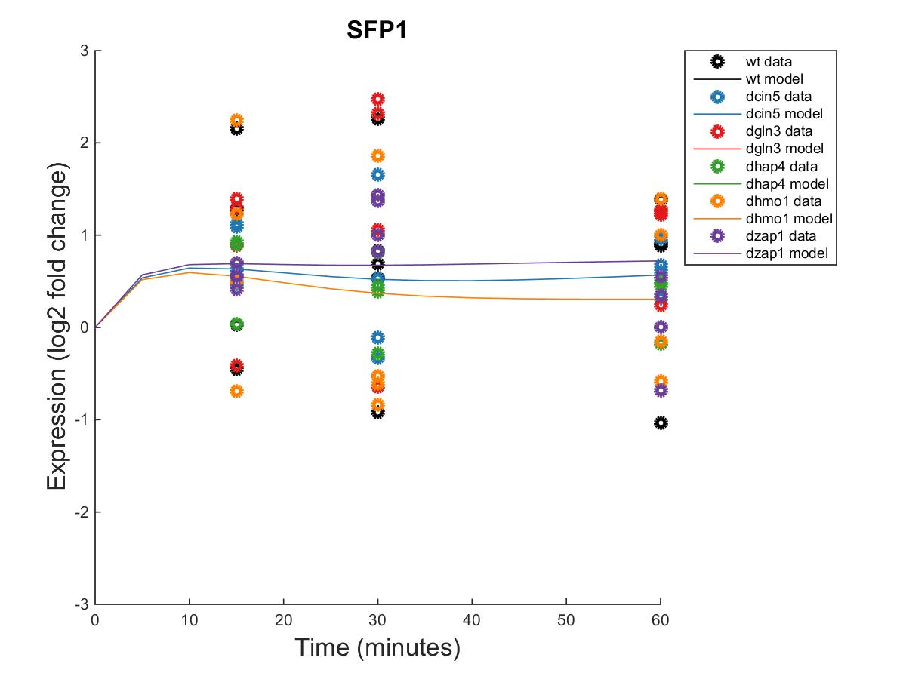
GRNmap Output Estimation of MSN2, RDS3, SFP1, and STB5

Slide 19
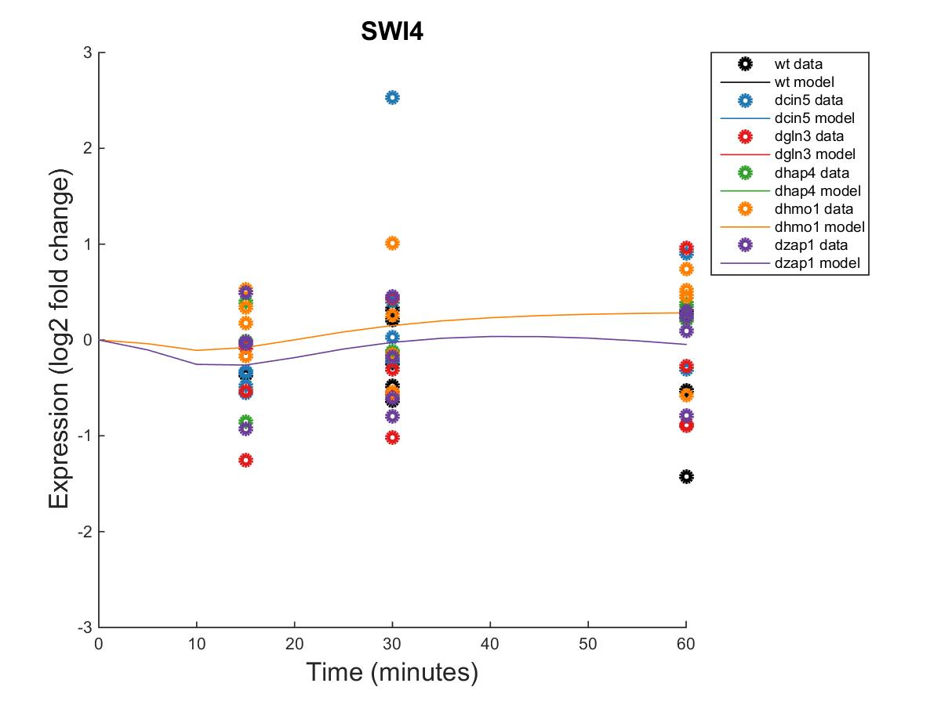
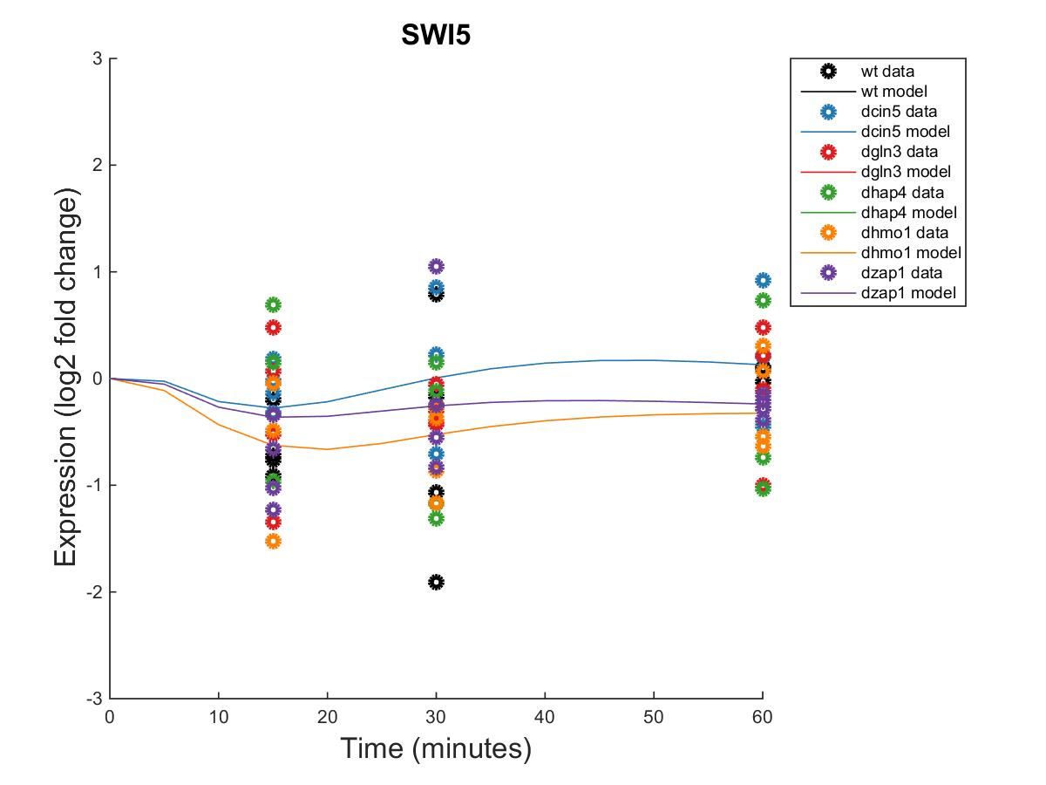
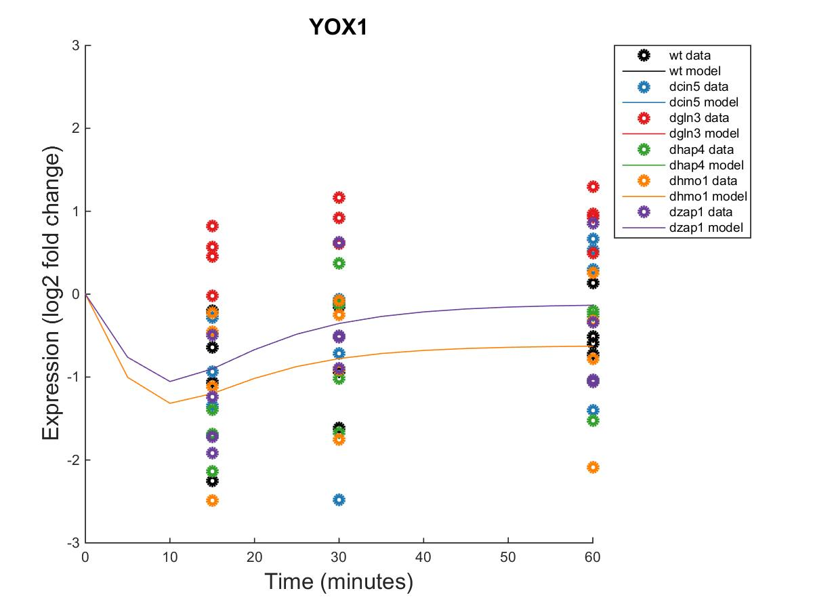
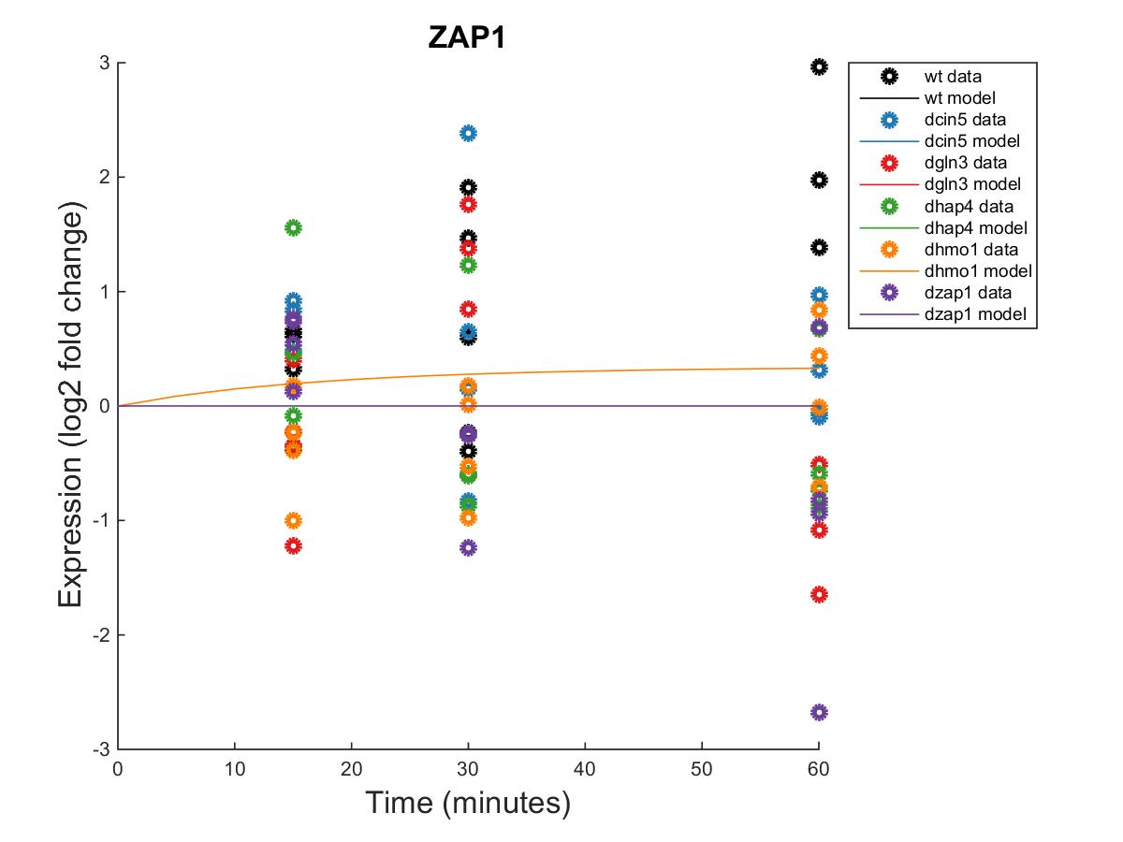
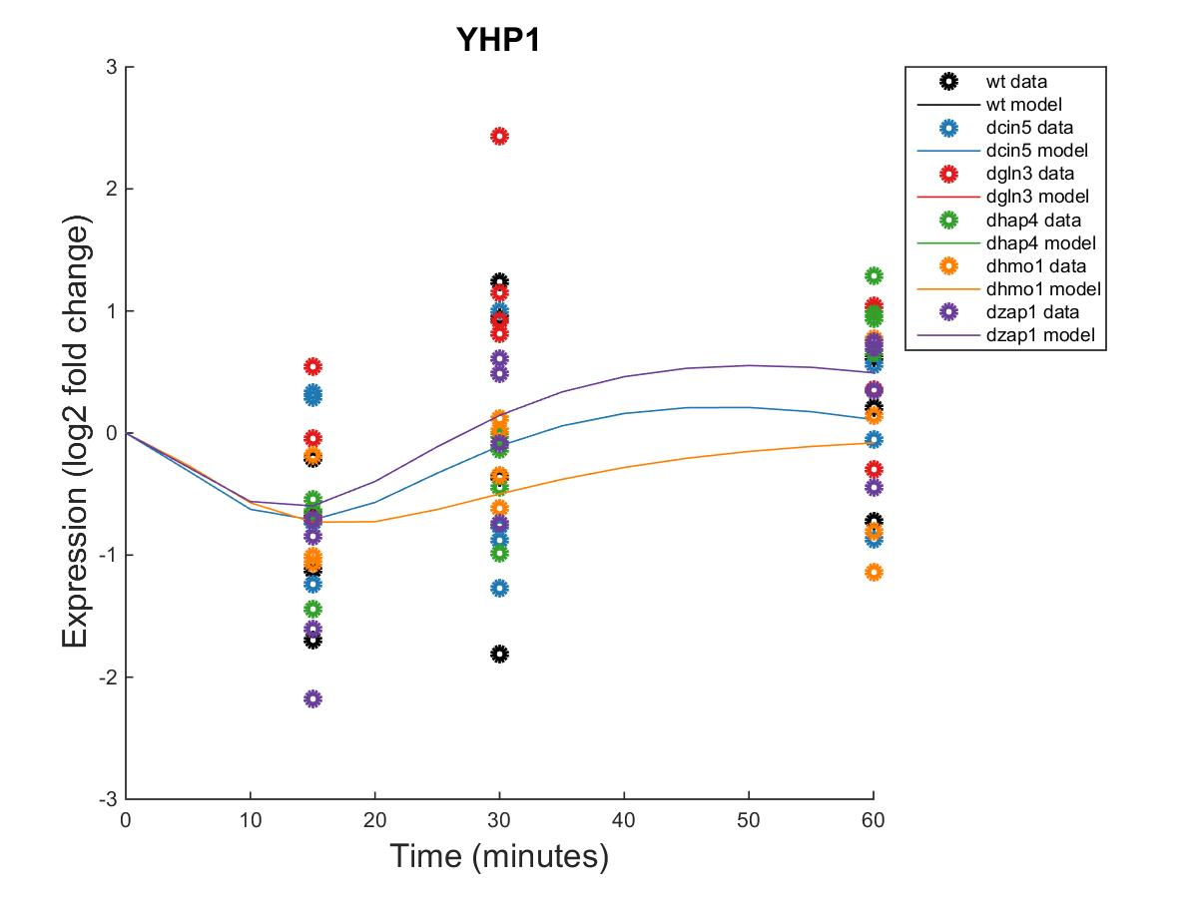
GRNmap Output Estimation of SWI4, SWI5, YHP1, YOX1 AND ZAP1

Slide 20
Weighted dCIN5 Network from GRNSight appears to have an equal distribution of high activation and repression.

Slide 21
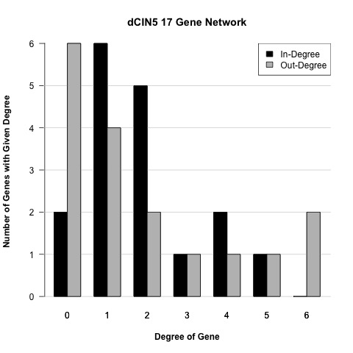

Slide 22
Optimized Production Rates and Threshold B Values for dCIN5 17 gene Network
id | threshold_b | production_rate
ACE2 | 1.4950 | 0.2233
CIN5 | 0.3752 | 0.8464
GCR2 | 0.2328 | 0.2328
GLN3 | 0.5978 | 0.2889
HAP4 | 3.1300 | 1.2711
HMO1 | 1.8877 | 0.5459
MCM1 | 0.2061 | 0.1443
MGA2 | -0.0327 | 0.2674
MSN2 | -1.8024 | 2.6109
RDS3 | 0.6593 | 0.1996
SFP1 | 0.7107 | 0.5865
STB5 | 0.1796 | 0.2471
SWI4 | -1.7389 | 0.2758
SWI5 | 0.1242 | 0.8183
YHP1 | 0.9109 | 0.7462
YOX1 | 0.0539 | 1.1141
ZAP1 | 0.1322 | 0.1322

Slide 23
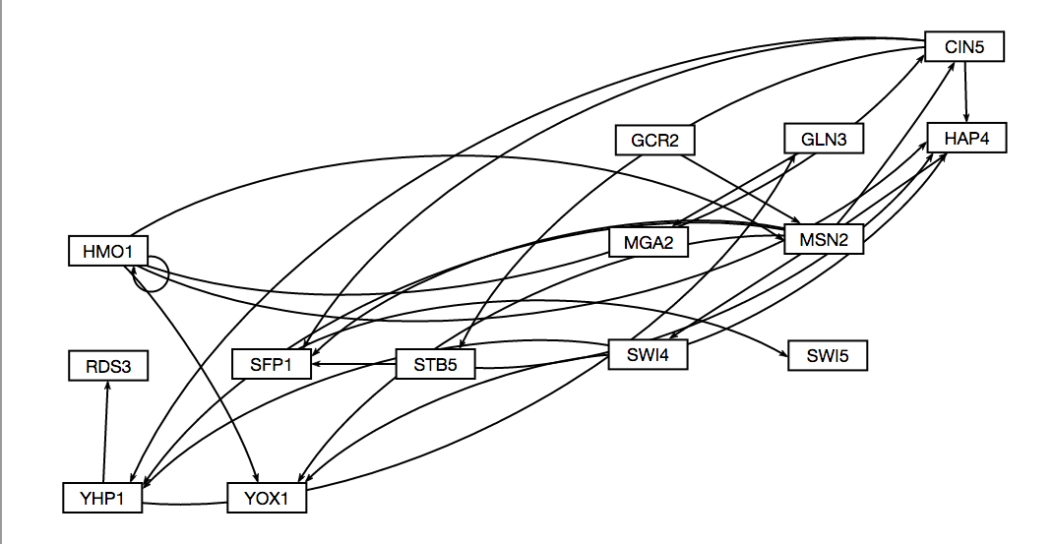
dCIN5 14 gene GRNmap Testing Results
dCIN5 Information:
14 Nodes (Genes)
25 Edges
Network Composed of the following genes:
CIN5
GCR2
GLN3
HAP4
HMO1
MGA2
MSN2
RDS3
SFP1
STB5
SWI4
SWI5
YHP1
YOX1

Slide 24
Parameter Output
Parameter | Value
Penalty Term | 1.8830
LSE | 0.6634
minLSE | 0.4885
LSE:minLSE ratio | 1.3580
Iteration Count | 53,862

Slide 25
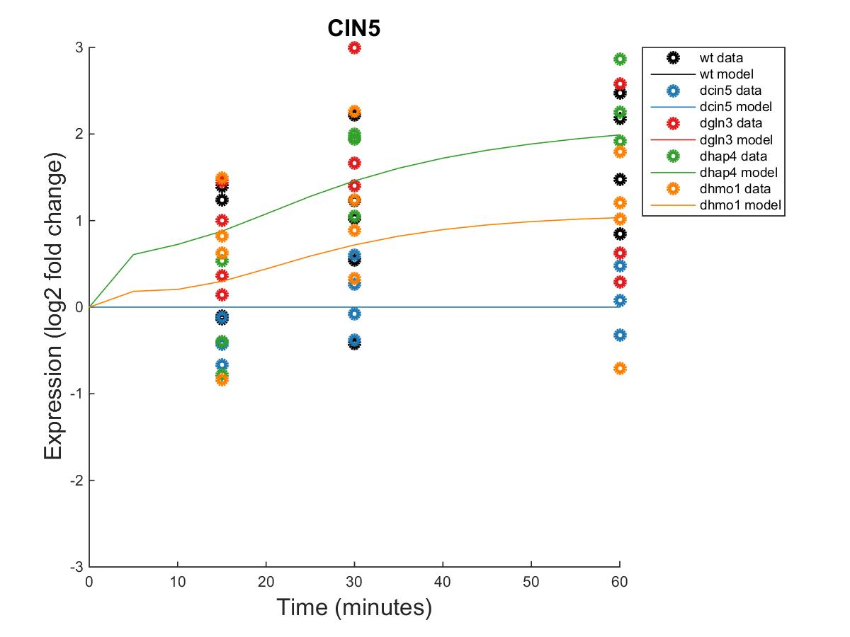
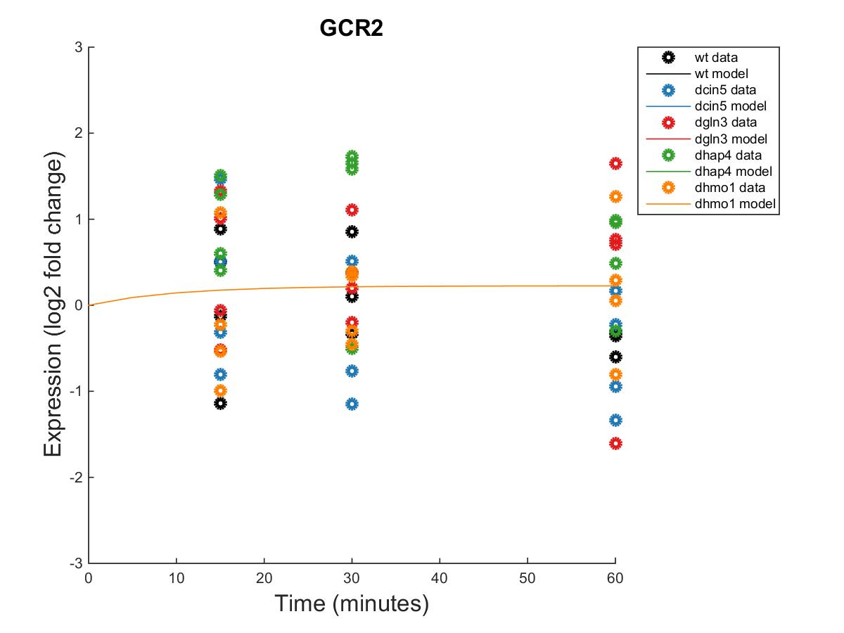


GRNmap Output Estimation of CIN5, GCR2, GLN3 and HAP4
Within Strain ANOVA
0.0662
0.6188
0.0163
0.0112
0.4113
Within Strain ANOVA
0.3306
0.5876
0.8763
0.1261
0.8445
Within Strain ANOVA
0.4189
0.5468
0.6094
0.5189
0.9281
Within Strain ANOVA
0.7307
0.4821
0.0773
0.4165
0.9262

Slide 26




GRNmap Output Estimation of HMO1, MGA2, MSN2, and RDS3
Within Strain ANOVA
0.0397
0.0022
0.0025
0.4244
0.5758
Within Strain ANOVA
0.0996
0.3003
0.4415
0.3822
0.4679
Within Strain ANOVA
0.3056
0.2208
0.3427
0.0168
0.8021
Within Strain ANOVA
0.2952
0.6149
0.5967
0.8469
1.0057

Slide 27




GRNmap Output Estimation of SFP1, STB5, SWI4, and SWI5
Within Strain ANOVA
0.4097
0.0494
0.0751
0.0533
0.8354
Within Strain ANOVA
0.3129
0.3692
0.3204
1.0193
0.4173
Within Strain ANOVA
0.6731
0.4839
0.3797
0.6155
0.9652
Within Strain ANOVA
0.0957
0.4463
0.3126
0.9868
0.5178

Slide 28


GRNmap Output Estimation of YHP1 and YOX1
Within Strain ANOVA
0.1743
0.8684
0.0433
0.0084
0.8152
Within Strain ANOVA
0.004
0.058
0.2181
0.0117
0.2197

Slide 29


Slide 30
Optimized Production Rates and Threshold B Values for dCIN5 14 gene Network
id | threshold_b | production_rate
CIN5 | -0.2500 | 1.5792
GCR2 | 0.2253 | 0.2253
GLN3 | 0.7220 | 0.4174
HAP4 | 2.1782 | 1.0796
HMO1 | 1.7324 | 0.5122
MGA2 | -0.0252 | 0.2725
MSN2 | -1.4075 | 2.1830
RDS3 | 1.0634 | 0.2958
SFP1 | -0.8488 | 1.4101
STB5 | 1.4014 | 0.6012
SWI4 | -0.5609 | 0.3355
SWI5 | -0.5153 | 1.1400
YHP1 | -1.8135 | 1.8826
YOX1 | -0.2274 | 1.3668

Slide 31
dGLN3 GRNmap Testing Results
As of: 2016 Oct. 30
dGLN3 Information:
14 Nodes (Genes)
35 Edges
Network composed of the following genes:
CIN5
CYC8
GCR2
GLN3
HAP4
HMO1
MSN2
MSN4
SFP1
SWI4
SWI5
TEC1
YHP1
YOX1

Slide 32
Parameter Outputs – dGLN3
Parameter | Value
Penalty | 1.7895
LSE | 0.6994
min LSE | 0.5379
LSE/minLSE ratio | 1.3000
Iteration count | 78,124

Slide 33




GRNmap Output Estimation of CIN5, CYC8, GCR2, and GLN3
Within Strain ANOVA
0.0662
0.6188
0.0163
0.0112
0.4113
0.0260
Within Strain ANOVA
0.8043
0.0930
0.5305
0.0975
0.9353
0.9604
Within Strain ANOVA
0.3306
0.5876
0.8763
0.1261
0.8445
0.3479
Within Strain ANOVA
0.4189
0.5468
0.6094
0.5189
0.9281
0.1171

Slide 34




GRNmap Output Estimation of HAP4, HMO1, MSN2, and MSN4
Within Strain ANOVA
0.7307
0.4821
0.0773
0.4165
0.9262
0.0157
Within Strain ANOVA
0.3056
0.2208
0.3427
0.0168
0.8021
0.0836
Within Strain ANOVA
0.0397
0.0022
0.0025
0.4244
0.5758
0.0011
Within Strain ANOVA
0.1887
0.1243
0.2398
0.0081
0.6214
0.0022

Slide 35



GRNmap Output Estimation of SFP1, SWI4, and SWI5
Within Strain ANOVA
0.6731
0.4839
0.3797
0.6155
0.9652
0.7799
Within Strain ANOVA
0.4097
0.0494
0.0751
0.0533
0.8354
0.0021
Within Strain ANOVA
0.0957
0.4463
0.3126
0.9868
0.5178
0.2975

Slide 36



GRNmap Output Estimation of TEC1, YHP1, and YOX1
Within Strain ANOVA
0.1743
0.8684
0.0433
0.0084
0.8152
0.0653
Within Strain ANOVA
0.0046
0.0078
0.0197
0.0654
0.2876
0.2627
Within Strain ANOVA
0.0040
0.0580
0.2181
0.0117
0.2197
0.2658

Slide 37


Slide 38
Unweighted dGLN3 Network

Slide 39
Weighted dGLN3 Network

Slide 40
Optimized Production Rates and Threshold B Values for the dGLN3 Network
id | production_rate | threshold_b
CIN5 | 1.2710 | 0.2094
CYC8 | 0.1608 | 0.9504
GCR2 | 0.2204 | 0.2204
GLN3 | 0.2845 | 1.4824
HAP4 | 1.2569 | 0.6142
HMO1 | 0.1829 | 0.8709
MSN2 | 0.5202 | 1.6614
MSN4 | 1.3203 | -0.0135
SFP1 | 1.1973 | -0.0214
SWI4 | 0.2878 | 0.7661
SWI5 | 2.3058 | -2.5539
TEC1 | 1.5765 | 0.3510
YHP1 | 0.5388 | 1.1083
YOX1 | 0.7925 | 1.6923

Slide 41
dHAP4 GRNmap Testing Results
As of: 2016 Oct. 30
dHAP4 Information:
15 Nodes (Genes)
28 Edges
Network composed of the following genes:
ACE2
ASH1
CIN5
GCR2
GLN3
HAP4
HMO1
MSN2
SFP1
STB5
SWI4
SWI5
YHP1
YOX1
ZAP1

Slide 42
Parameter Outputs – dhap4
Parameter | Value
Penalty | 2.3443
LSE | 0.6919
min LSE | 0.4851
LSE/minLSE ratio | 1.4263
Iteration count | 62,139

Slide 43




GRNmap Output Estimation of ACE2, ASH1, CIN5, and GCR2
Within Strain ANOVA
0.7624
0.4462
0.7855
0.2916
0.8258
0.0457
Within Strain ANOVA
0.0829
0.0091
0.5202
0.0723
0.7639
0.4535
Within Strain ANOVA
0.0662
0.6188
0.0163
0.0112
0.4113
0.026
Within Strain ANOVA
0.3306
0.5876
0.8763
0.1261
0.8445
0.3479

Slide 44




GRNmap Output Estimation of GLN3, HAP4, HMO1, and MSN2
Within Strain ANOVA
0.4189
0.5468
0.6094
0.5189
0.9281
0.1171
Within Strain ANOVA
0.7307
0.4821
0.0773
0.4165
0.9262
0.0157
Within Strain ANOVA
0.0397
0.0022
0.0025
0.4244
0.5758
0.0011
Within Strain ANOVA
0.3056
0.2208
0.3427
0.0168
0.8021
0.0836

Slide 45




GRNmap Output Estimation of SFP1, STB5, SWI4, and SWI5
Within Strain ANOVA
0.4097
0.0494
0.0751
0.0533
0.8354
0.0021
Within Strain ANOVA
0.3129
0.3692
0.3204
1.0193
0.4173
0.3296
Within Strain ANOVA
0.6731
0.4839
0.3797
0.6155
0.9652
0.7799
Within Strain ANOVA
0.0957
0.4463
0.3126
0.9868
0.5178
0.2975

Slide 46



GRNmap Output Estimation of YHP1, YOX1, and ZAP1
Within Strain ANOVA
0.1743
0.8684
0.0433
0.0084
0.8152
0.0653
Within Strain ANOVA
0.0089
0.316
0.2503
1.0134
0.8824
0.4562
Within Strain ANOVA
0.004
0.058
0.2181
0.0117
0.2197
0.2658

Slide 47


Slide 48
Unweighted dHAP4 Network

Slide 49
Weighted dHAP4 Network

Slide 50
Optimized Production Rates and Threshold B Values for the dHAP4 Network
id | production_rate | threshold_b
ACE2 | 0.1632 | 0.6002
ASH1 | 2.0268 | -1.7884
CIN5 | 0.9511 | 2.3690
GCR2 | 0.2351 | 0.2351
GLN3 | 0.2878 | 0.8206
HAP4 | 1.6726 | 0.7266
HMO1 | 0.2387 | 0.9680
MSN2 | 0.8824 | 4.7489
SFP1 | 1.2094 | 1.0399
STB5 | 0.3204 | 0.5771
SWI4 | 0.2412 | 0.3262
SWI5 | 1.2497 | -0.5910
YHP1 | 0.3411 | 2.3043
YOX1 | 0.8646 | 2.0954
ZAP1 | 0.1298 | 0.1298

Slide 51
dZAP1 GRNmap Testing Results
As of: 2016 Oct. 30
dZAP1 Information:
16 Nodes (Genes)
27 Edges
Network composed of the following genes:
ABF1
ACE2
CIN5
CST6
GCN4
GCR2
GLN3
HAP4
HMO1
HSF1
MCM1
MGA2
MSN2
MSN4
SWI4
ZAP1

Slide 52
Parameter Outputs – dZAP1
Parameter | Value
Penalty | 1.8276
LSE | 0.8602
min LSE | 0.6156
LSE/minLSE ratio | 1.3973
Iteration count | 76,769

Slide 53




GRNmap Output Estimation of ABF1, ACE2, CIN5, and CST6
Within Strain ANOVA
0.0055
0.0148
0.1095
0.0004
0.5993
0.0895
Within Strain ANOVA
0.7624
0.4462
0.7855
0.2916
0.8258
0.0457
Within Strain ANOVA
0.0662
0.6188
0.0163
0.0112
0.4113
0.026
Within Strain ANOVA
0.0005
0.5571
0.3191
0.3863
0.4009
0.0376

Slide 54




GRNmap Output Estimation of GCN4, GCR2, GLN3, AND HAP4
Within Strain ANOVA
0.6297
0.2761
0.2751
0.5058
0.9118
0.5207
Within Strain ANOVA
0.3306
0.5876
0.8763
0.1261
0.8445
0.3479
Within Strain ANOVA
0.4189
0.5468
0.6094
0.5189
0.9281
0.1171
Within Strain ANOVA
0.7307
0.4821
0.0773
0.4165
0.9262
0.0157

Slide 55




GRNmap Output Estimation of HMO1, HSF1, MCM1, and MGA2
Within Strain ANOVA
0.0397
0.0022
0.0025
0.4244
0.5758
0.0011
Within Strain ANOVA
0.1345
0.0295
0.0488
0.015
0.5281
0.0159
Within Strain ANOVA
0.9354
0.093
0.8677
0.1031
0.9311
0.9415
Within Strain ANOVA
0.0996
0.3003
0.4415
0.3822
0.4679
0.5113

Slide 56




GRNmap Output Estimation of MSN2, MSN4, SWI4, AND ZAP1
Within Strain ANOVA
0.3056
0.2208
0.3427
0.0168
0.8021
0.0836
Within Strain ANOVA
0.1887
0.1243
0.2398
0.0081
0.6214
0.0022
Within Strain ANOVA
0.6731
0.4839
0.3797
0.6155
0.9652
0.7799
Within Strain ANOVA
0.0089
0.316
0.2503
1.0134
0.8824
0.4562

Slide 57


Slide 58
Unweighted dZAP1 Network

Slide 59
Weighted dZAP1 Network

Slide 60
Optimized Production Rates and Threshold B Values for the dZAP1 Network
id | production_rate | threshold_b
ABF1 | 0.0576 | 0.0576
ACE2 | 0.2315 | 1.5390
CIN5 | 1.9157 | -0.5369
CST6 | 0.2917 | -0.0235
GCN4 | 0.0456 | -0.9424
GCR2 | 0.2278 | 0.2278
GLN3 | 1.3572 | -0.4477
HAP4 | 1.7046 | 0.1702
HMO1 | 0.2390 | 0.3849
HSF1 | 0.1079 | 0.0950
MCM1 | 0.1429 | 0.2643
MGA2 | 0.3076 | -0.0397
MSN2 | 1.3539 | -0.6478
MSN4 | 1.4054 | 1.7175
SWI4 | 0.2128 | -2.7446
ZAP1 | 0.1307 | 0.1307

